Slide 1
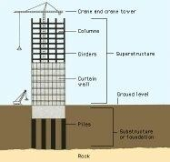
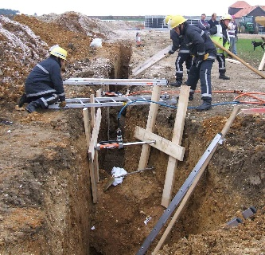
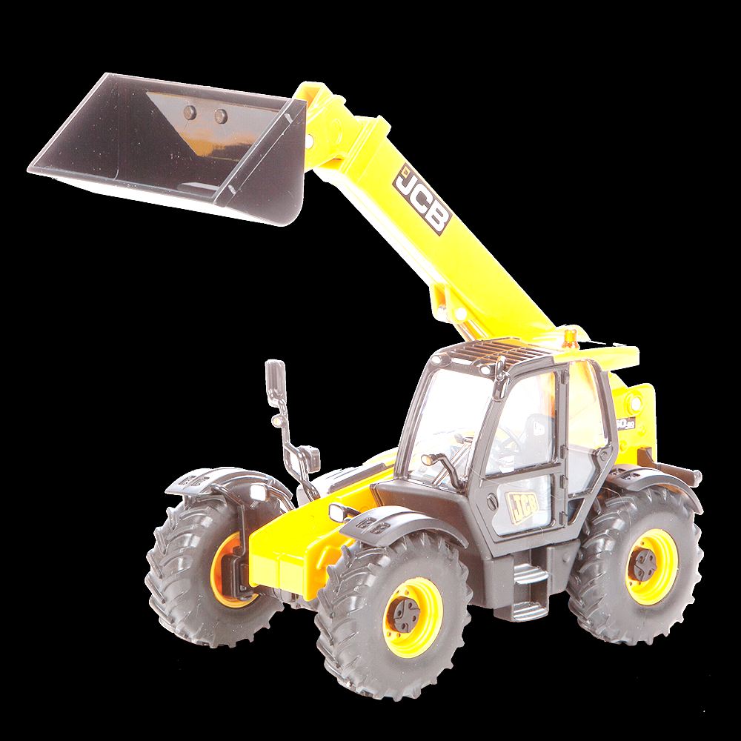
Desk-based Pre-Construction
Pre-construction work on site
Before any practical construction can take place, some things need to be organised in an office setting.
Identify 3 types of pre-construction activities and explain why these are important (6 marks).
Planning
Programme
A scaled site layout plan needs to be prepared. There needs to be a site office, storage areas for materials, temporary road access and parking for contractor vehicles.
There also needs to be toilet facilities for workers and security fences so that the public cannot access the construction site.
Fire precaution measures are also considered at this stage.
An accurate programme of work needs to be put together. This should detail what needs to be done, in what order and when it should be completed.
A construction always has a deadline date so it is important that everything is done on time and in the correct order.
Health and Safety
Demolition
Setting up a site
In a project using traditional construction methods, setting up a site will include many considerations such as deciding an entrance and exit point to keep control of what goes in and out. The site will need to avoid access points on roads that are very narrow or busy and the size of the entrance will be decided by the largest item that will need to fit through it.
A health and safety plan needs to be put into place to keep workers safe on site.
Risk assessments are written to ensure that every worker knows how to operate equipment safely.
The site must be cleared of any vegetation and trees. Any existing structures must also be knocked down.
Any existing services such as water, gas, electricity must be protected.
Sub-Structure Groundworks
Hazards associated with groundworks
Substructures are things that are constructed below ground level to support a superstructure.
Superstructures are the framework of the building, the walls, floors and roofs.
To construct a substructure such as the foundations for a building, the ground needs to be excavated. This means digging into the ground, usually with large JCB’s, to be able to lay the foundations.
CONFINED SPACE OR COLLAPSE OF SIDES OF EXCAVATION.
Risk: Crushing/Death
Control Measures: Wearing appropriate PPE, limiting time in confined spaces, using trench supports.
A building has to be designed and constructed to fulfil certain performance requirements. It has to be strong and stable but it also needs to do other things such as resist fire and bad weather.
Loads are the various forces acting on a structure such as a building and the building needs to be strong enough to sustain certain loads such as:
GAS
Risk: Injury or Death
Control Measure: Avoiding services such as gas mains before excavating.
PRESENCE OF GROUNDWATER
Risk: Flooding or Drowning
Control Measures: Pumping out excess water
WATER PIPES/ ELECTRICITY CABLES
Risk: Injury, death or power outages.
Control Measures: Locate and protect all services before work begins
PROXIMITY OF MACHINERY
Risk: Injury or Death Control Measures: Barriers to stop machinery from getting too close to areas with workers
DEAD LOAD
This is a load that does not move, such as the weight of the building itself
DYNAMIC LOAD
These are loads that can change during the use of the building, such as the load from people and furniture.
IMPACT
This is when something hits a part of the building or falls on it, such as a heavy object.

Slide 2
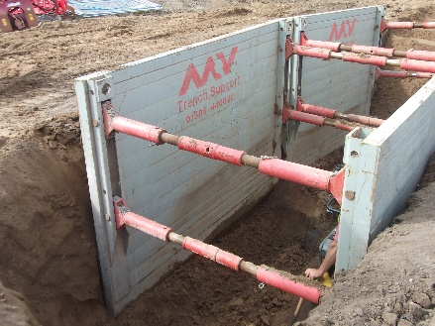
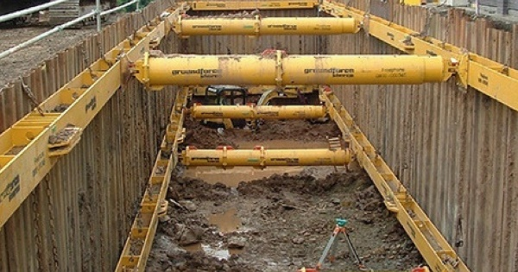
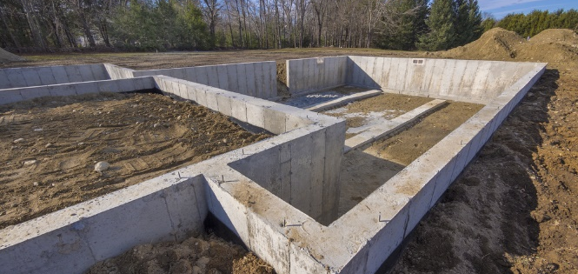
Trench Support
Foundations
When digging trenches for strip and mass fill foundations, the sides of the excavation need support so that the soil does not collapse, which may cause danger to construction workers. There are a variety of ways in which this can be done:
A foundation is designed and constructed to safely transmit the loads of the building to the ground or sub-soil. They should be able to support the loads of the building for it’s entire lifespan.
The foundations should be able to withstand the dead and dynamic loads of the building.
Before foundation types are decided, a number of factors regarding the structure and the site it is to be constructed on will have to be considered. These include the:
weight of the proposed structure
purpose of the proposed structure
soil composition of the proposed site
history of the proposed site
feasibility of costs.
Exam Question: Sketch a diagram to show the timbering method of earthwork support for a trench. Annotate your diagram.
Strip Foundations
Deep Strip (Mass Fill) Foundations
Strip foundations are the cheapest form of foundation available to constructors.
Strip foundations involve the digging of a trench. Concrete is then poured into the strip/trench, sometimes on top of reinforced steel grids and tampered level.
Strip foundations can only be used on firm, good load-bearing soil, and are generally used for low rise buildings such as extensions.
Similar to a strip foundation but without the need for reinforcement bars.
Deeper trenches can be dug and filled with concrete providing more stability.
Because of the amount of concrete used, it is more expensive.
The advantages are that workers do not need to go into the trench to start building the brick/blockwork, as a result, it is a faster method.
Exam Question: Outline the advantages and disadvantages of using a mass fill foundation over a strip foundation. (4 marks)

Slide 3
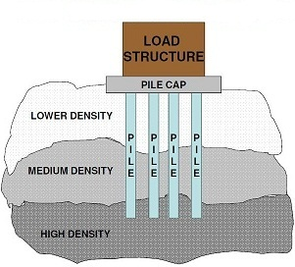
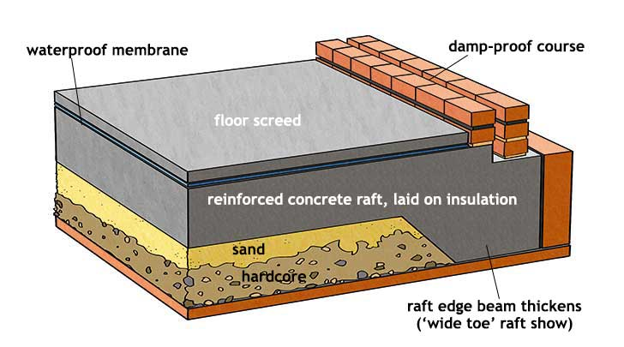
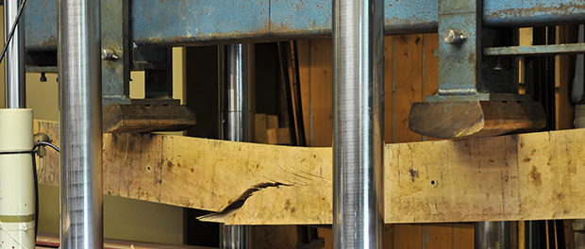
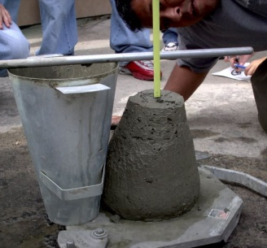
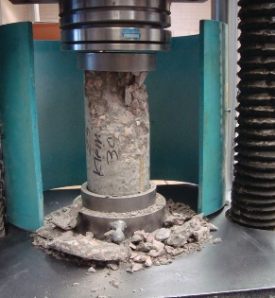
Raft Foundations
Pile Foundations
A raft foundation is a reinforced concrete slab under the whole of a building or extension, 'floating' on the ground as a raft floats on water.
This type of foundation spreads the load of the building over a larger area than other foundations, lowering the pressure on the ground.
Raft foundations are suitable for ground with a poor load bearing capacity.
Using sand for example, if you were to poke your fingers into sand they would sink to a certain depth. However, if you were to hold your hand flat across the same sand, the sand would offer more resistance due to the load being applied across a greater area. This is the principal of a raft foundation.
A pile is basically a long cylinder of a strong material such as concrete that
is pushed into the ground to act as a steady support for structures built on top of it.
They are expensive as large machinery is needed to drill into the ground.
Pile foundations are used in the following situations:
When there is a layer of weak soil at the surface. This layer cannot support the weight of the building, so the loads of the building have to bypass this layer and be transferred to the layer of stronger soil or rock that is below the weak layer.
When a building has very heavy, concentrated loads, such as in a high rise structure, bridge, or water tank.
Materials used in Construction- Concrete
Materials used in Construction- Timber
Concrete is made up of three basic components: water, aggregate (rock, sand, or gravel) and cement. Cement, usually in powder form, acts as a binding agent when mixed with water and aggregates. Concrete needs to be tested for strength before it is used in Construction applications to make sure it can support any weight or forces acting upon it. It can be done in two ways:
Is used in structures such as the frames of buildings or roof trusses, as well as in doors and windows. The strength of various types of timber is tested. Timber is then sorted into various groups. This process is called stress grading or strength grading.
Timber strength ranges from 14 N/mm2 to 70 N/mm2. When it is being specified, the letter C (coniferous) means softwood and the letter D (deciduous) means hardwood. This means that timber is classified from C14 to C50 and D30 to D70. A D30 timber is a hardwood with a strength of 30 N/mm2. The strength class is usually stamped on the timber.
Slump Testing
Compressive Strength Testing
Slump testing checks that the ratio of water and cement in wet concrete is correct. If wet concrete loses it’s shape or ‘slumps’ too easily, the balance is not right.
Compressive strength testing checks that the hardened concrete is strong enough to withstand loads. This can be done by putting it in a hydraulic press.

Slide 4
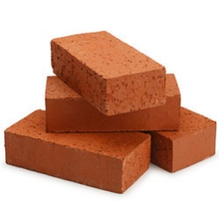
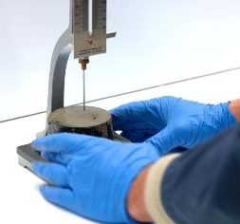
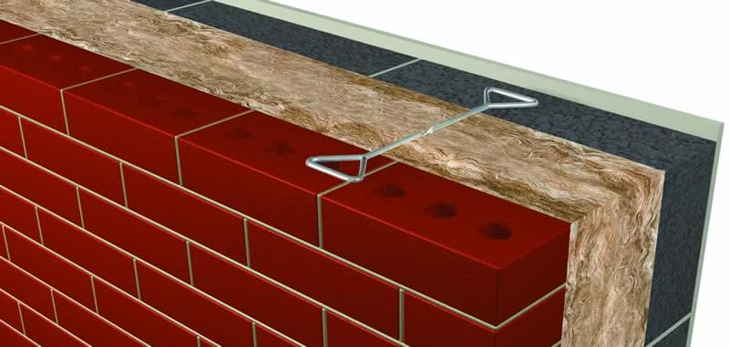
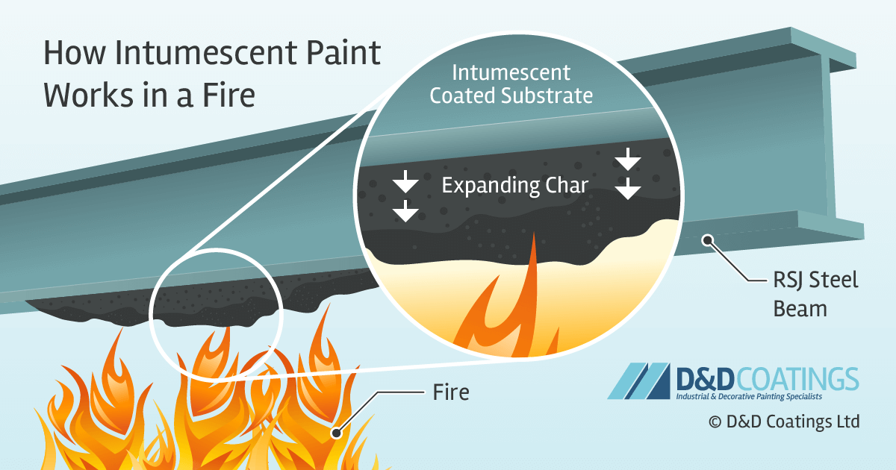
Bricks Mortar Hardcore
Cavity Walls
Cavity walls are constructed as two halves, called skins or leaves. The gap between the two skins is called a cavity, which is normally filled with insulating material above ground level. Below ground level it is filled with concrete to make it both stronger and more stable.
As a cavity wall is constructed in two halves, wall ties are provided to connect these together. This makes sure the wall will stay in place and will not move. Wall ties should be provided every 900mm horizontally and every 450 mm vertically.
These are classified according to their strength and the amount of moisture that they can absorb. Bricks are usually made from clay.
All bricks should have a minimum strength of 5N/mm2.
Mortar is a workable paste used to bind, fill and seal building blocks such as stones, bricks, and concrete masonry units together.
Testing is done by making cubes of mortar to check how much water can pass through it, or if there are any gaps causing leakage.
This is used to provide an even base under floors. It is a mix of gravel, sand, broken bricks and crushed concrete also known as aggregate.
It is classified based on the size of the pieces of material in the mixture. The higher the number in the classification, the larger the pieces are.
Plasterboard
Practice: Sketch a diagram showing the transfer of loads from the walls into the foundations.
Blockwork
Wall Tie
Insulation
Brickwork
Fire Resistance- Materials
Fire Resistant Design
Fire- resistant buildings can save lives and damage to property. Fire resistance can even make sure a building stays standing after a fire.
The design of a building can also affect it’s fire resistance. Buildings are usually divided up into sections called fire compartments, so that a fire in one compartment will not affect the others. These compartments are separated by features known as fire barriers. These include fire walls and separating floors made out of concrete, door closers which stop doors being left ajar, and fire resistant doors that are steel, painted with intumescent paint. This stops the spread of fire and helps firefighters to put out a fire.
When building a new structure, it can be best to build using fire-resistant materials which include:
CONCRETE
BLOCKWORK
PLASTERBOARD
Intumescent paint is a paint which swells when heated. This makes it fire resistant, as when it is heated up by fire, it expands and becomes a thicker layer on top of the painted material. This slows down the transfer of heat to the painted material.
Practice: Design and annotate a ground floorplan which would utilise fire compartments.
Exam style question: Explain what measures need to be taken to ensure that buildings are fire resistant.

Slide 5
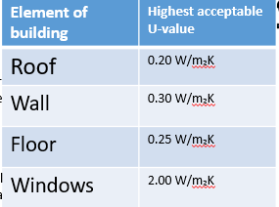
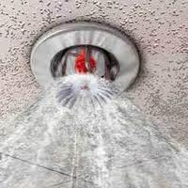
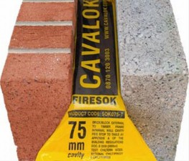
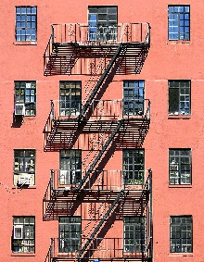
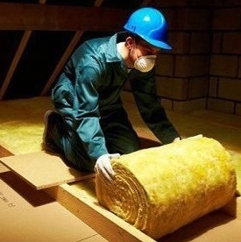
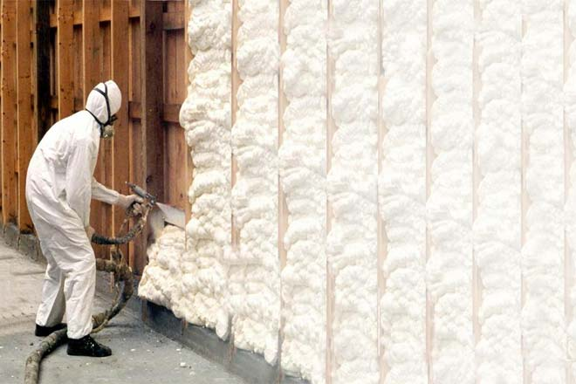
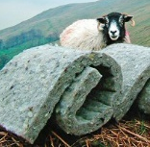
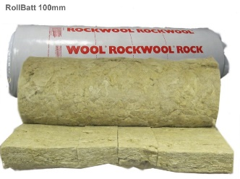
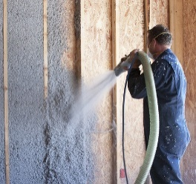
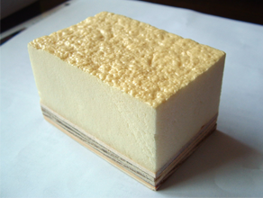
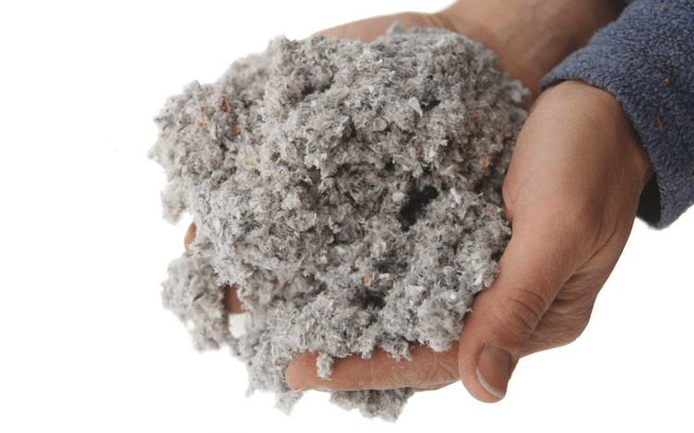
Fire Resistance Equipment
Fire alarm systems and smoke detectors- these help to alert people to the fire as soon as possible, making it easier to get everyone out of the building quickly and safely.
Thermal Insulation
Fire Escapes- these allow people to reach safety without using the stairs or lifts inside a building. Fire escapes are often attached to the sides of buildings.
Buildings have to be comfortable to live in. However, buildings are not airtight so they lose heated air through gaps in their structure or in the materials used to construct them. This is why buildings need thermal insulation.
A poorly insulated building will use more energy to maintain a comfortable temperature inside. This means that the energy costs will be higher. A well insulate building uses less energy and so is cheaper to heat.
Sprinkler systems- these help to put out fires, especially small fires. They are located in the ceiling and switch on automatically when a fire is detected.
Cavity fire barriers- these are used to stop the spread of a fire through cavities in a building such as in a wall or ceiling.
Refuge areas- these are fire resistant areas inside a building, designed to be used by less able-bodied people or people with reduced mobility.
U-values are used to measure heat loss from any element of a building. A lower U-value means that the building element is well insulated. The Building Regulations Approved Document L specify the U-values for various elements of a buildings. These are shown in the table.
Types of Thermal Insulation- 1
Types of Thermal Insulation- 2
GLASS FIBRE OR MINERAL WOOL
Made from recycled glass and silica.
Advantages
Fire Resistant
Does not rot
Can be recycled
Disadvantages
Made from silica, which is not a renewable material
Carbon emissions during it’s production.
SHEEP’S WOOL
Advantages
Can be reused and recycled
Absorbs extra moisture
Disadvantages
Has some non-renewable material
Thermal conductivity can increase if compressed
ROCK MINERAL WOOL
Made from rocks
Advantages
Fire resistant
Does not rot
Can be recycled
Disadvantages
Production is not environmentally friendly
Can cause temporary skin irritation.
CELLULOSE
Made from recycled newspapers
Advantages:
Made from recycled material
Can be reused and recycled
Disadvantages:
Paper dust during installation
Can release gases from the printing inks on the recycled paper.
FOAM
Made from crushed glass
Advantages:
Can be recycled
Has good compressive strength
Disadvantages:
Production is not environmentally friendly.
Exam Question: A construction company is looking to install insulation in a timber framed wall. Compare and contrast two suitable insulation materials that could be used.

Slide 6
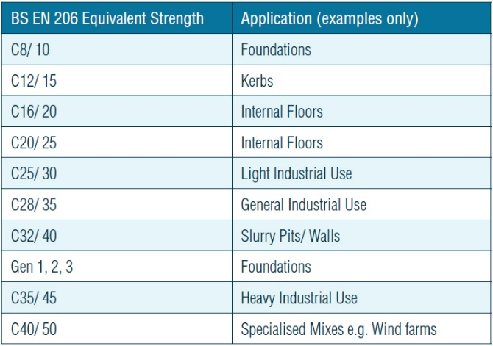
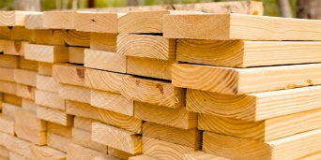
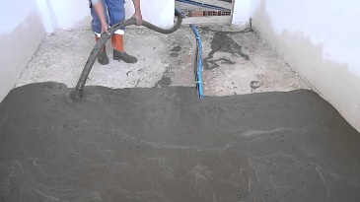
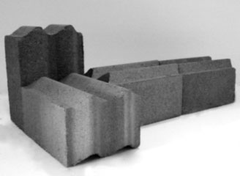
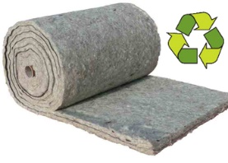
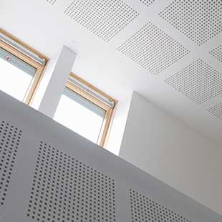
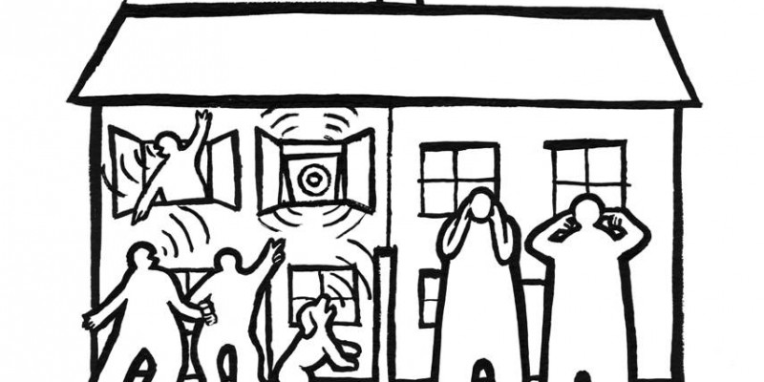
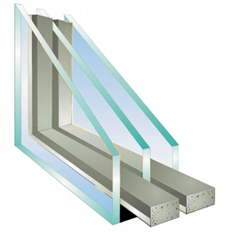
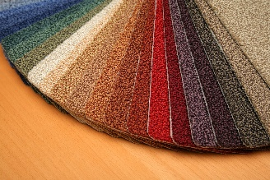
Thermal Resistance
Strength Testing Concrete
Buildings can also be constructed from materials that resist the movement of heat. This means that less heat escapes through them and so they need less insulation. These materials have thermal resistance and they include:
Available strengths of concrete range from 8N/mm2 (Newtons per millimetre squared) to 60N/mm2. When specifying materials, concrete with a strength of 25 N/mm2 is written as C25.
Aerated lightweight concrete blocks- these can be used to construct walls. The blocks are made of aerated concrete, which is concrete with a lot of air in it. Air is very insulating when it is trapped between solid layers – for instance, when it is cold and you put on an extra jumper, you trap a layer of air between the layers of clothing, which insulates you from the cold.
Lightweight screed- this is made with lightweight aggregates. These contain more air, so lightweight screed gives good insulation.
Timber- this can be used to create features such as window frames and doors. It can also be used to construct timber-framed buildings.
The higher the number that is next to the letter C, the stronger the concrete is.
If concrete is to be used to take the load of a structure, it’s strength should be at least 25N/mm2.
Practice: Study the table. Which of these applications requires the strongest concrete? Explain how you came to this conclusion.
Sound Insulation
Types of Sound Insulation
1
2
When sound travels inside a building, it bounces off the walls, ceilings and floors. Sound can also travel in from outside, from passing vehicles or passers-by. This sound can travel inside through windows, doors or external walls. This creates noise and thus affects the human comfort of the people using the building- that is, it makes it less enjoyable for people in there.
Heavy Density Blockwork
Used to construct sound-resistant walls between adjacent rooms and flats.
2. Sound Insulation Quilt
Usually used in floors and cavity walls as well as in ceilings and under floors.
3. Acoustic Ceilings
Made up of special materials that absorb sound and are used where good sound transmission is required, such is in theatres, music rooms or home cinemas.
4. Plasterboard Layers
Generally used in insulating both solid walls and cavity walls.
5. Triple Glazing
Used in doors and windows.
6. Flooring, Mats and Carpets
These can be an effective form of sound insulation as they absorb noise. If no carpets are provided, the sound will bounce off the walls and floors resulting in noise.
A building should be insulated to resist letting sound through it’s structure. This means that people living in one house are not disturbed by noise from their adjacent neighbour. Good sound insulation is important in improving quality of life by reducing external noise into the building, such as traffic or the sound of overhead aircraft. It also ensures privacy, so that your next-door neighbour cannot hear your conversations!
3
4
5
6

Slide 7
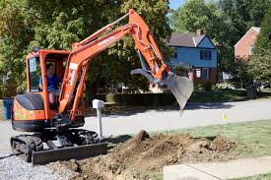
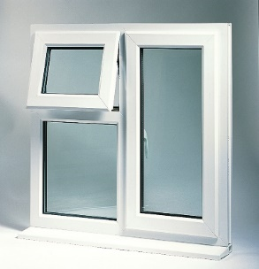
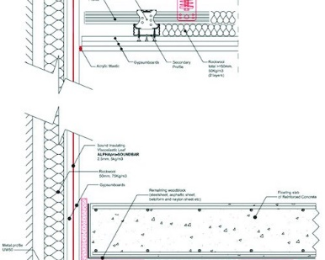
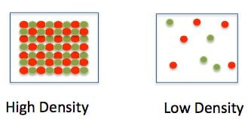
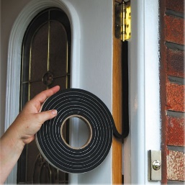
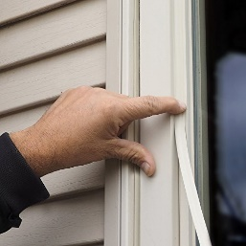
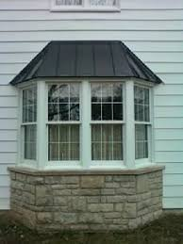
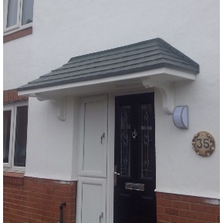
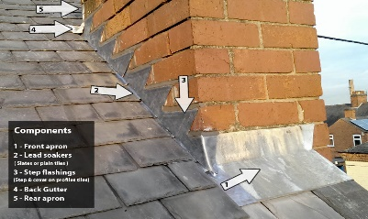
Provision of Sound Insulation
Dividing the building structure in a way that sound does not travel into another part. This is called sound isolation of a structure. For example, in larger buildings, one part can be detached from another.
Weather Resistance- 1
One of the ways in which buildings can be weatherproofed is to use waterproof and impervious materials such as:
Good sound insulation can be achieved by:
Buildings are designed and constructed to provide a comfortable environment for their occupants. This means that they should protect people from weathering elements such as heat, cold, humidity and rainwater.
These weathering elements can also damage the building and it’s finishes. For instance, if rainwater can enter a building through the roof, this will not only stain the walls but also damage them, reducing the building’s useful life.
Increasing the density of a material. This means that the speed of sound trying to pass through these materials is slowed down.
Plastics such as PVC
To make guttering, soffits and window frames. PVC is a plastic and is very weather resistant, particularly against water. Mastic can be used to keep ventilation ducts weatherproof, as it stops the weather penetrating through.
Using machinery silencers. These help to reduce the noise from machinery used in the construction process. This is especially important when working on a site adjacent to other houses.
Weather Resistance- 2
1
2
Sustainability-1
Research:
1. How is coal formed? 2. How is oil and gas formed? 3. Why are fossil fuels so sought after? 4. What are fossil fuels used for? 5. What does ‘non-renewable resource’ mean? 6. What are the disadvantages of using fossil fuels?
1. Weather stripping
These are strips of vinyl that are used to close the gaps in a door or window so that the building is weatherproof. Draught strips are also used so that the building is airtight and does not lose heat.
2. Rubber weather seals and sealants
These are applied to doors and windows to stop water from entering the building. Seals and sealants do so by either blocking the entry or letting it drain.
3. Overhangs (Eaves)
Overhanging eaves above the window also protects it from weathering elements.
4. Falls
These are slopes provided on outer frames of doors and windows as well as on sills so that these can easily shed the water off.
5. Flashings
These are metal sheets, usually made of lead, used to cover the joins between the roof and a feature protruding from the roof, such as a chimney. This makes the structure weatherproof.
In the UK, the majority of our electricity is produced through burning fossil fuels such as coal, gas and oil. These fossil fuels account for just over 60% of the country's total power generation. Although eco-friendly sources are beginning to become more common, with wind energy taking the lead, these do not yet come close to producing the same level of power as fossil fuels.
Fossil fuels are a finite resource, meaning that they cannot be replenished within a human lifetime. This means that the construction industry needs to incorporate methods of reducing energy consumption in buildings.
3
4
Youtube Video: Fossil Fuels 101
5

Slide 8
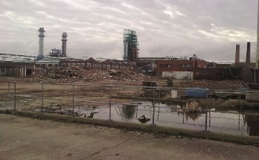
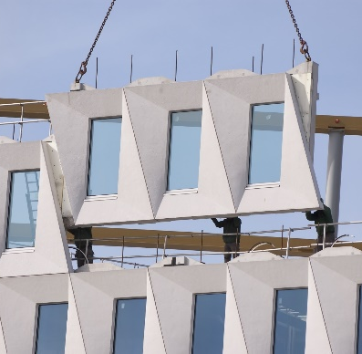
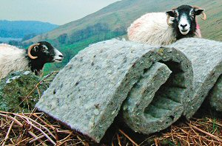
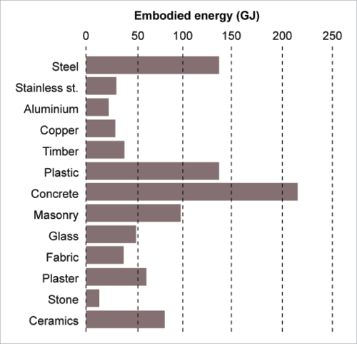
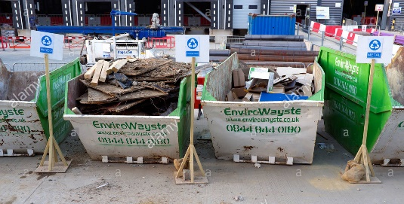
Sustainability-2
Methods of Sustainable Construction- 1
Reduce carbon emissions to the atmosphere- when fossil fuels are burned (for instance when a car uses petrol or a power station burns coal), carbon dioxide is released into the atmosphere.
Over time, this causes the Earth’s temperature to rise, causing issues such as rising sea levels and droughts. It also causes air pollution.
A sustainable building is designed and constructed to make as small an impact on the natural environment as possible. Sustainability aims to:
In order to construct a truly sustainable building, sustainability must be part of it’s initial design. This can be as simple as making sure that the building is facing the right way! To achieve sustainability, the following things should be done:
Conserve natural resources- natural resources such as water and timber are limited. These need to be used carefully so that there is enough for future generations, so wastage of these resources should be avoided.
Achieve reduction in building energy use- this not only reduces energy costs but also reduces the impact of fossil fuels on the environment
Re-use brownfield sites
This reduces the number of greenfield sites that are used for construction and so keeps a maximum amount of green space. As brownfield sites have usually been built on, it may also mean that less energy would be needed to redevelop sites.
Achieve maximum sunlight through building orientation:
A building in the UK that faces south will get the maximum amount of natural sunlight. This can reduce the amount of electricity the building uses.
Methods of Sustainable Construction- 2
Sustainable Materials- 1
Use sustainable materials
that are from renewable sources in construction activities. For example, sheep’s wool insulation is a sustainable material because the wool needed to make it can be regrown and so is renewable.
Instead of throwing away old items, such as copper tubing, you can reuse and recycle them. These recycled materials use less energy to be produced and thus have low embodied energy. They are more sustainable than those made from all-new raw materials. Another example is aluminium, which is found in earth but can also be re-used by re- melting it.
Embodied energy is the energy consumed by all of the processes associated with the production of a building, from the mining and processing of natural resources to manufacturing, transport and product delivery.
Recycle waste by separation and reuse
Site waste is separated as people put domestic waste into different bins so that it can be easily recycled. Material can be reused as well, such as reusing old bricks and crushing waste concrete.
Research:
How many different processes are involved in the production of plastic?
Why is plastic considered unsustainable?
Reduce time and wastage by using local suppliers
As well as ordering the right quantities of materials and using pre-fabricated materials.

Slide 9
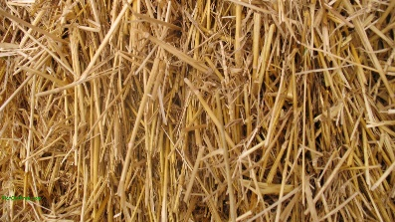
Sustainable Materials- 2
Sustainable Materials- 3
STRAW
Straw bales can be used to build walls and even entire houses.
Remember that MATERIALS are different to products. Any material that can be grown in abundance is considered sustainable.
LIME
This is a natural, renewable substance used to make mortar. Unlike cement mortar, lime-based mortar can be removed when a structure is knocked down, which means that bricks can be recycled. Lime can also be used in rendering.
SHEEP’S WOOL
This can be used as insulation. It is more sustainable than most artificially made insulation materials.
HEMP
Hemp comes from the cannabis sativa plant. It has excellent insulation properties and can be mixed with lime to make insulation products. Hemp is considered to be ‘carbon negative’. This means that it removes more carbon CO2 from the atmosphere than it is responsible for creating.
CEDAR
This is a type of wood used for cladding. It has natural resistance to moisture and humidity and gives excellent insulation.
Softwoods can be grown in a sustainable way.
ALUMINIUM
This is a soft metal that is easily melted down and recycled. It can be used instead of PVC to make guttering and downpipes.
Cross Wall Construction
Structurally Insulated Panels (SIP’s)
In cross-wall construction, the front and back of the building is constructed as non-loadbearing, while loadbearing walls are at right angles to these walls. This leads to the name cross-wall. The floor between these cross-walls is connected to all four walls and provides lateral restraint.
This form is suitable for blocks of flats or apartments, as it is ideal for creating similar floors. They are quick to construct as components such as whole walls can be made off-site. The bare concrete walls can painted or clad straight away reducing the time spent on finishing.
Our school was made using this method of construction. The walls are cast from concrete in a factory and then transported to site and assembled. It is a more sustainable form of construction as pre-fabricated materials reduce the amount of wastage produced on site.
These are insulated timber panels that are strong enough to take loads. They have a central layer of insulation, with a plywood face on each side. SIPS construction is similar to timber-framed construction but is faster and large panels can be made to speed up the process.
The method provides a lighter frame, is thermally efficient and helps to reduce site waste. Because the panels are wooden, fire resistance could be an issue.
Youtube- ‘What structural insulated panels are all about’
Exam Questions:
Name two external finishes used with SIP’s (2 marks)
Explain two benefits of using SIP’s rather than a traditional structural form. (4 marks)

Slide 10
Timber Framed Construction
Frames provide space for services (gas pipes, electrical wiring etc) and are thermally efficient. Timber frames are finished using a variety of secondary finishes, including brickwork, rendered blockwork, cedar cladding, tiling and UPVC cladding.
Features of Timber Framed Buildings- Damp Proof Course (DPC)
Timber framing is commonly used in houses. The frames are made of softwood and faced (or covered) with plywood. Loadbearing timber walls are made up of small timbers called studs. Short timber pieces called noggins are placed between them to give them stability.
Moisture can penetrate the building from the foundations or under floors. A damp-proof course (DPC) stops moisture coming in from the foundations, while a damp-proof membrane (DPM) is provided under the floors for the same purpose.
As can be seen in this image, the DPC is visible between the blockwork and the concrete foundation.
Exam Question:
Sketch a cross section through a cavity wall. Identify and the label the DPC and DPM. (5 marks)
Timber framed construction is a sustainable form of construction as it uses softwood which can be grown sustainably. It can be constructed with a high level of accuracy and in less time than traditional construction.
Features of Timber Framed Buildings- Finishes and Cladding
Features of Timber Framed Buildings- Insulation and Moisture Resistance
Brickwork
Cedar cladding
Cement rendering
Timber-framed buildings can be finished like any other type of building and can even be given the look of a traditional building with a brickwork finish. These finishes are attached to the timber frame using flexible wall ties.
1
Insulation- insulation is provided between the timber studs. Insulation is tied to these studs so that there are no gaps.
3
KEY TERMS
uPVC cladding- a covering made of uPVC (unplasticised polyvinyl chloride).
Shingles- a roofing material, generally made of cedar wood.
2
Moisture resistance- a polythene sheet, called a vapour check, is built in between the internal wall and the insulation to stop moisture penetration.

Slide 11
Features of Timber Framed Buildings- Plywood sheets and Lintels
Where would the DPC be on this diagram?
Ground Floors- Solid
KEYWORD
Studs- the timber frame is made of a number of upright timbers called studs.
A ground floor is the floor of the lowest level of a building. Ground floors can be either solid or suspended.
A solid floor bears directly onto the ground from which it gains its support. It is usually made of solid concrete. Solid floors are made up of:
Insulation- This should have good compressive strength.
Plywood sheets- these are attached to the external wall to provide bracing (strength and rigidity).
Lightweight screed
Sand blinding- a layer of sand to even off the surface of the hardcore.
Practice:
Identify three features of a timber framed construction.
List two ways in which waste can be reduced in timber-framed construction.
Lintels- where openings are provided for windows and doors, a small beam called a lintel is used to direct rainwater away from the opening. Timber studs are also placed around these openings to add strength.
Damp proof membrane- prevents transfer of moisture from the ground into the building
Hardcore to provide a strong base
Ground Floors- Beam and Block Floor (Suspended)
Walls
A wall performs a number of functions such as:
Resisting heat transfer
Reducing sound transmission
Transferring loads to foundations
Providing shelter and security
Timber framed construction
This is a type of suspended floor which means it is suspended above the ground. It uses precast concrete beams with lightweight concrete blocks as infill. The method is becoming very popular as it is quick to construct and ensures a high quality.
These floors do not need preparation and put less of a load on the foundations. As they are precast, they can be laid in bad weather.
Detailing a wall: This is the process of producing a drawing that contains all the details about the construction of a wall, such as the materials to be used and the wall’s size.
The floor of a building is split up using internal partitions which then creates individual rooms in a building. They can be constructed in different ways such as:
Solid Blockwork
Metal stud walls- usually used where glass panes are required
Due to the floor being suspended above the ground it limits the transfer of moisture from the ground into the floor.

Slide 12
Walls- Materials Used
Walls- Finishes
When finishing a wall in brickwork, care must be taken so that the colour and appearance of the brickwork does not vary too much and so that the finished look is as pleasing as possible.
Mortar is a mixture of sand and lime, or sand and cement with or without lime. Lime makes the mortar more workable but as it is more porous (lets moisture through) it allows frost to penetrate and cause damage.
Rendering blockwork- this is similar to plastering but is usually placed on the outside of the building and can be given different textures.
Facing brickwork- usually has various types of joints with pointing. Joints improve the weather proofing and appearance of the brickwork. Weather-struck and bucket handle joints provide better weather resistance, as water can run off. Flush and recessed joints give a better appearance.
Thin joint masonry is a faster method of constructing walls. As the name suggests, the joints between various layers are thin compared to traditional methods. These joints are 2 to 3mm thick. A fast-setting mortar is used, which can give the required strength very quickly. This masonry depends on the accuracy of block sizes. Generally, lightweight blocks are used, which also provide good thermal efficiency.
KEY TERM
Pointing- filling joints in brickwork with mortar to improve appearance and weather proofing.
Walls- Openings
Floors- Materials used
1
2
Openings have to be included in walls to provide ventilation, sunlight and improve the aesthetics (attractiveness). Common wall openings include:
Floors inside a building other than the ground floor are constructed using a wide range of materials. These include:
Concrete- beam and block floors use precast concrete beams with lightweight concrete blocks as an infill.
Timber- suspended floors can be constructed using different types of timber joists, which are like beams and support the floor load. Some joists are not solid and have open areas providing space for services. These are eco-joists and use less timber.
Engineered timber- newer buildings may have floors made of applied finishes such as laminate and engineered timber. These need less maintenance and are less likely to be effected by moisture and rot.
3
Sill- A piece of material below a door or window to allow rainwater to run off.
Weep hole- A small opening in brickwork which allows moisture to escape.
Cavity tray- A damp-proof course inside a cavity wall, which funnels moisture out of the cavity wall.
Threshold- A strip of material forming the bottom of a doorway.
Lintel- A horizontal support across the top of a wall opening, such as a door or window.
Cavity closer- This closes off the cavity around a wall opening, reducing heat loss.
4
Beam and Block floor- used in larger buildings
5
6
Timber suspended floor- used in smaller buildings

Slide 13
Floors- Finishes and Components
Roofs
Solid floors can be finished in screed, which provides a level and even surface. Additional floor finishes such as carpets can be laid on top of this.
Floors could be finished using ordinary chipboard, moisture-resistant chipboard or softwood. A wooden board called a skirting board is provided along the bottom of the wall. This is used to make the joint between the wall and a floor look more attractive and protects the wall base as well.
Function of a roof
Roofs are designed and constructed to be able to support their own weight as well as resist loads due to their finishes and other loads such as snow and wind. A roof should be able to:
Discharge rainfall away from the building, usually through overhanging eaves and guttering.
The floor is made up of joists or beams suspended between supporting walls which support the load from the floor. Joists are supported by the walls. They can either rest on the wall or be connected using special components called hangers. These are attached to the side of a wall and receive the joists.
Make the structure weatherproof
Provide a recreational area in the case of green roofs (roofs covered in grass and plants)
Be aesthetically pleasing, through the use of roof tiles and finishes
Provide extra accommodation or space.
Details of roofs
Comparison of Flat and Pitched Roofs
A roof can be constructed as flat or pitched. Types of pitched roofs can include lean-to, mono pitch, double pitch, gable end and hipped end.
Flat Roof
Advantages
Aesthetically pleasing.
Provides parapet feature in the building (like a balcony).
Ease of maintenance.
Forms recreational areas.
Disadvantages
Water run-off may be difficult, causing puddles on the roof.
Solar reflective paint required, which needs to be maintained.
Extra hardwearing surfaces might be needed.
Pitched Roof
Advantages
Aesthetically pleasing.
Better water run-off.
Less maintenance needed.
Creates more floor space or storage space
Roofers install roofing battens (rafters), attach the roofing felt and tile the roof. Roofing work starts quite early in the construction stage so that it is weatherproof before work begins inside.
Disadvantages
Initial cost higher than a flat roof.
Takes longer to build.
Difficult to access for maintenance.

Slide 14
Roofing Terminology
A roof is made of components that support the load or weight of the structure. These can be made of timber, concrete or steel. Insulating materials and materials that provide resistance to moisture are also used. Pitched roofs are finished using a variety of tiles such as natural slates, clay and concrete tiles. A flat roof is finished using waterproofing materials. Both flat and pitched roofs drain rainwater away through a system of drainage pipes.
Benefits and Downsides of using pre-fabricated production
Different parts of a roof have names. It is important to know this terminology.
Before a decision is made whether a building is to be constructed using off-site construction, an evaluation needs to be carried out. This means that the benefits and downsides need to be considered.
Benefits
No storage is needed as components are brought to site just-in-time.
Off-site manufacture reduces the need to work at height, making accidents less likely.
Working conditions improve as less site work means less noise and dust.
Quality of the finished product is much higher.
Less on-site skilled labour is needed and productivity improves as it is quicker to build.
Off site manufacture is under factory conditions, where there will be minimum waste produced. This is better for the environment.
Downsides
It can take a long time to make and deliver the components.
Excellent management skills are needed to co-ordinate the project activities.
The cost of the components can be very high
Understanding Constructional Sketches
In the exam you may be asked to draw or label a diagram. There are standardised symbols or images used to represent a variety of building materials and components used which will make identifying parts of a diagram easier.
Hardcore
Concrete
Damp Proof Membrane
Screed
Brick
Earth
Exam Question: Draw a cross section of a strip foundation. Annotate your diagram.

