Slide 1
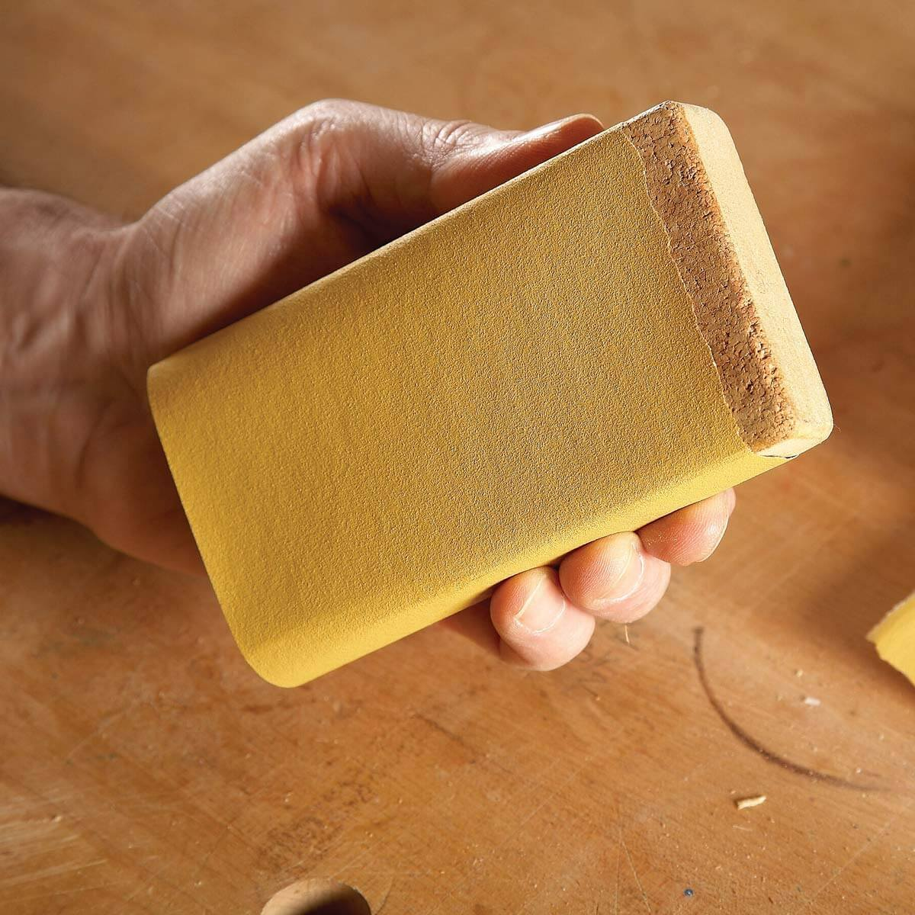
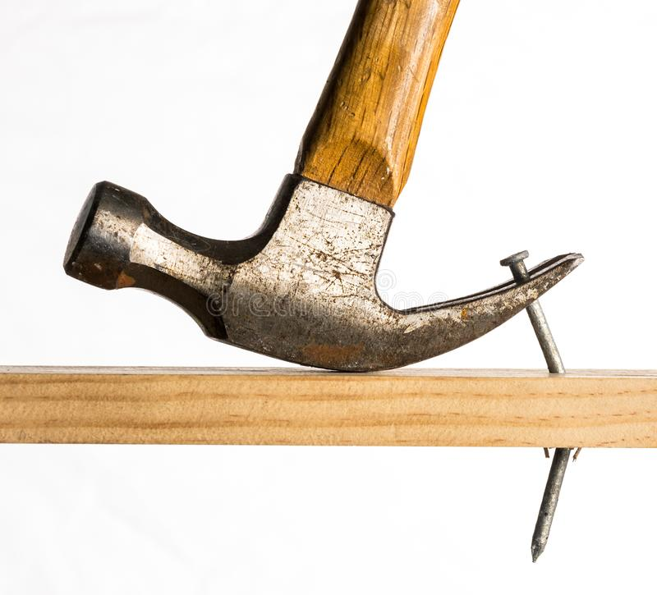
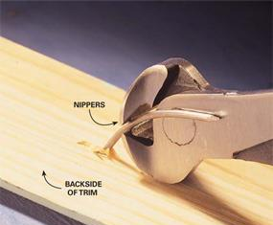
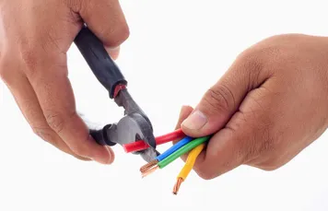
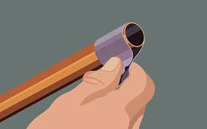
H&S Unit 10
Small practical activities to add ‘real life’ experience, or important examples of good practice. You will need to ‘make this your own’, change it as necessary, it’s a working document.
It does not matter if you revisit these during another Unit, the experience will reinforce the learning process
You can tailor or change these ideas to suit your own objectives and teaching style and inject your own knowledge and experiences into the situation, use your own common sense and judgement to adjust tasks or information as necessary
TRADE | ACTIVITY | OBJECTIVE | OUTCOME | RESOURCES/LINKS
Joinery | Taking the arris of a piece of softwood etc | To explain the potential risk of injury from a sharp edge/splinter to an operative and to explain the practical application for this action i.e. providing a finish. | Learners learn how to flatten/round a potentially sharp edge using different sandpaper grades. | Correct PPE https://www.youtube.com/watch?v=NNDuupkxIME
Carpentry | Taking a wire nail out of a block of softwood etc | To explain the potential risk of injury from a nail that is sticking out of a length of timber | Learners learns how to use a claw hammer or maybe pincers to remove nail safely | Correct PPE https://www.youtube.com/results?search_query=Taking+a+wire+nail+out+of+timber+using+a+claw+hammer
Electrics | Cutting and stripping wire etc | To learn about the potential risk of injury from flying fragments of wire | Learners to use correct PPE and procedures when carrying out these operations | Correct PPE https://www.youtube.com/results?search_query=cutting+and+stripping+flex
Plumbing | De-burring copper pipe | To explain the potential risk of injury from a burr to an operative and to explain the practical application ie. Fitting pipework together. | Learners de-burr a freshly cut pipe and gain an awareness of the potential risks. | Correct PPE https://www.youtube.com/results?search_query=deburring+copper+pipe
Brickwork | Lifting and handling/or cutting a brick |  |  | Lifting Video/Demo/Looking after the body?
Painting | Scraping of residue paint etc | To learn about the the potential risk of injury from using a scraping device i.e. a tool with a sharp edge. | Learners learns how to use a sharp edge correctly, they learn about method and process | Correct PPE https://www.youtube.com/results?search_query=scraping+paint+of+glass
Decorating | Cutting in/burning off paint/masticing etc
Maintenance | Cleaning of Mould etc | They learn about the potential hazards to the operative whilst removing mould | Correct use of PPE and an understanding of precedure | See H&S Plumbing slides

