Slide 1
The Use of Mathematics in Construction
Unit 2
BTEC FIRST

Slide 2
Scenario
You are working as a trainee quantity surveyor for a local construction company who have been commissioned to design and build a house.
The land is in the form of a trapezium as shown in Figure 1. The footprint of the house to be constructed is 10 m x 8 m. The house will be constructed with a pitched roof.
You will deal with all the matters relating to the project where application of mathematical knowledge is required. This would include calculations of areas and volumes, plotting graphs and using algebraic and graphical methods to solve problems.
Before construction work starts, you will carry out calculations to ensure that the materials used are of appropriate strength.

Slide 3
Calculations of areas regularly used in building
b = 20mm h = 25mm area =
w = 25mm h = 15mm area =
a = 15mm b = 25mm h = 10mm area =

Slide 4
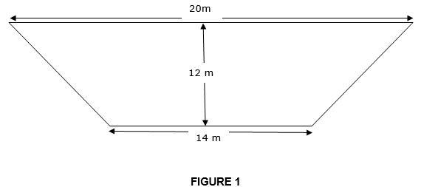
Task 1 (a)
The site is to be cleared before construction work starts.
The contractor requires the area calculations before a price is quoted. Calculate the area of land shown in Figure 1.
Remember to work out the surface area of a trapezium $\frac{1}{2}\left(a+b\right)x$h
Notes:
20+14 = 34m² 34m² x 12m = 408m² x $\frac{1}{2}=204m$² (squared)
Blah de blah
Formula to help is v = xc

Slide 5
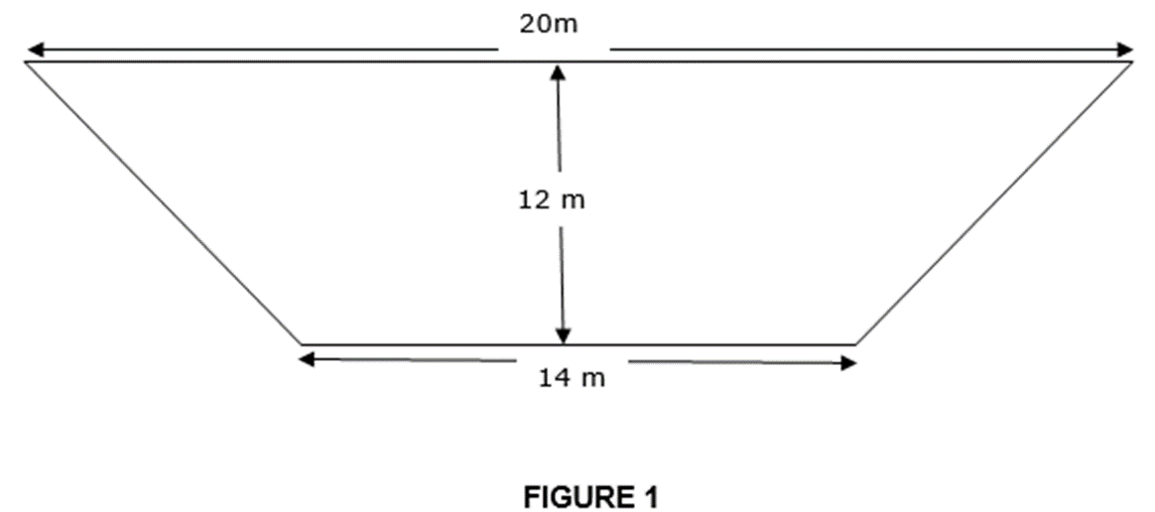
Task 1 (b)
If the topsoil removed is 200 mm thick all over the site, what is the volume of this topsoil?

Slide 6
Depth of removal = 200mm
200mm = 20cm = 0.2m
Volume = size of the plot x thickness of top soil
Notes:
204m² x 0.2 Volume = 40.8m³ (meter cubed)

Slide 7
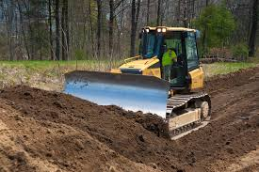
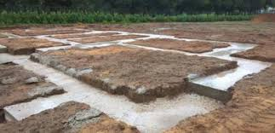
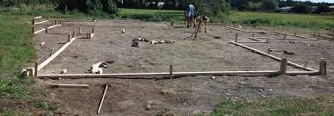
How to Dig the Foundations: How to Build an Extension
https://www.youtube.com/watch?v=2jNNRbbkKYU

Slide 8
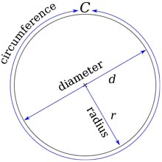
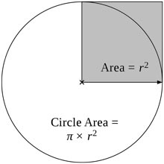
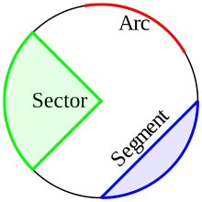
DIAMETER : RADIUS : CIRCUMFERENCE : 𝝿
Throughout Unit 2 we will be investigating and using practical maths.
The next section looks at the use of radii, diameter & $π ($3.14).
The definition of pi : the ratio of a circle's circumference divided by its diameter.
No matter the size of the circle you are measuring, the ratio of circumference to diameter will always equal 3.1415926535897, usually shortened to 3.14.
https://www.youtube.com/watch?v=YokKp3pwVFc

Slide 9
How to calculate the surface area of a tube
Notes:
Area of top + area of bottom + area of side

Slide 10
Task 1 (c) (i)
The plot of land is to be fenced using 50 mm diameter hollow posts (no tops and no bottoms) and safety fencing. The pipes will be painted to protect against the weathering agents. The posts are to be placed on concrete pad foundations of 300 mm × 300 mm × 500 mm.
(i) Calculate the surface area required to paint a post of 2.5 m length.
Calculate quantity of concrete required for foundation of one post.
https://www.safesitefacilities.co.uk/knowledge-base/security-fencing-construction-sites

Slide 11
50mm
(i) How would you calculate the surface area of a post that is 2.5 m long?
2.5m

Slide 12
Length of each post = 2.5m
Diameter of each post is given at 50mm (for this calculation to work we must change all of our given sizes into the same denominations, in this case into metres)
To change 50mm into metres you will have to multiply it by 1000 (there are 1000mm in 1m) or in other words move the point 3 decimal places

Slide 13
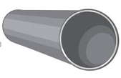
The calculation that we are going to use to find the Circumference - C of the post is 2𝝿RxL
So we need to work out the Radius -R, which would be half of the Diameter -𝞥
Diameter = 0.05m/2 = 0.025m
2𝝿R = 2 x 𝝿 x 0.025 = 0.157m
Surface area = C x length = 0.157m x 2.5m = 0.393m² ( even it out – 0.39m²)
During Task 1c)i we have found out that each external surface of each pipe would take 0.39m² of paint to cover it
Would we need to paint the insides?
How much paint would we need to paint 100 pipes?
Notes:
100 posts = 100 x 0.39m² = 39² of paint.

Slide 14
Task 1c)ii – Calculate the quantity of concrete required for the foundation of one post in m².
300mm
300mm
500mm
Notes:
0.5m x 0.3m x 0.3m = 0.045m³

Slide 15
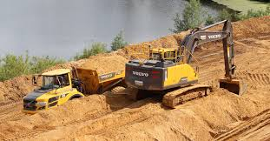
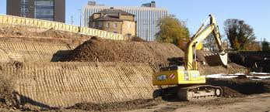
Task 1 (d)
Earthworks are to be carried out before construction work could start. You have received quotations from two plant companies A and B. Company A uses a plant that will require 12 hours to complete the job while company B’s plant could do it in 7 hours. Applying your knowledge of mathematics, calculate the time required to complete earthworks if your manager decides to employ both companies
A
B
Notes:
Ask class how they would tackle this task? Key is to find a common denominator.

Slide 16
As we found out previously that the tasks often give us the information in different denominations i.e. Metres and Millimetres.
In this case we can solve the problem by changing the ‘work rates’ into fractions -
Company A at a rate of $\frac{1}{2}$
Company B at a rate of $\frac{1}{7}$
Next step is to add these two fractions together but they need to have a common denominator. The bottom numbers need to be to be the same!
How do we achieve this?

Slide 17
One way is to change both of the bottom numbers into 84th
Company A = $\frac{7}{84}$
Company B = $\frac{12}{84}$
So in 1 hour both A + B will complete
$\frac{7}{84} + \frac{12}{84}$ = $\frac{19}{84}$
The next step is to divide 84 by 19
Answer = 84 ÷ 19 = 4.42 hours for both companies to complete the work.

Slide 18
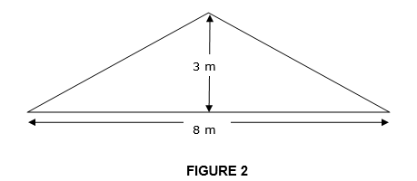
Task 1 (e)
Using details in Figure 1 and 2, calculate:
(i) area of the roof required for tiling
Information from Scenario/Slide 2
The land is in the form of a trapezium. The footprint of the house to be constructed is 10 m x 8 m. The house will be constructed with a pitched roof.

Slide 19
This picture shows the dimensions previously provided.
Task 1 e) asks us to work out the surface area of the roof.
What would you do to work out this area?
?
33m
10m
8m
Notes:
Apply Pythagoras Theorum c=$a2+b2$

Slide 20
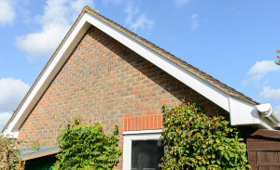
Think of the gable end as being made up of two triangles to help us find the hypotenuse C
C the hypotenuse = ?
A = 3m
B=4m
Roof span = 8m
We will apply Pythagoras Theorem c = $a^{2}+b^{2}$
Can you work out C?

Slide 21
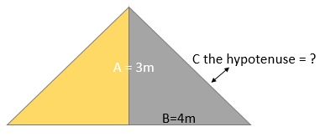
A = 3m, B = 4m, C = ?
Applying Pythagoras Theorum = –
C = A²+B²
= (4)²+(3)²
(C)² = 16 + 9
C² = 25
C = $\sqrt{25}$
C = 5
What is the total area of the Roof to be tiled?

Slide 22
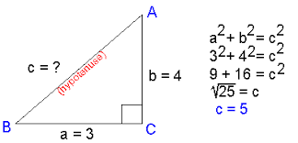
The area of the roof to be tiled =
10m x 5m x 2 surfaces = 100m²
Notes:
Talk about 3:4:5 triangles.

Slide 23
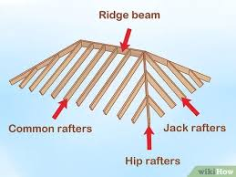
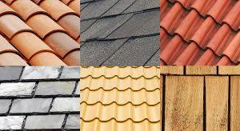
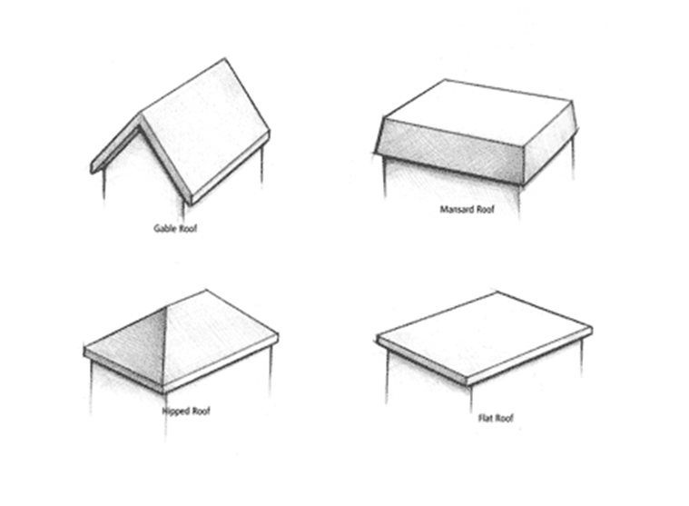
https://www.youtube.com/watch?v=n0CrtpuWL4w

Slide 24
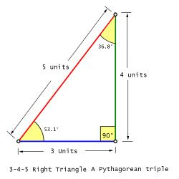
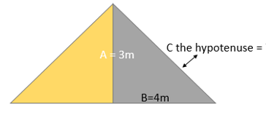
Task 1 e) ii What is the pitch of the roof (the angle the slope makes)?
Interior Angles
Because it is a right angled triangle one of the angles will be a right angle. Which one?
The sum of the interior angles will always add up to 180$º$
In fact a 3:4:5 triangle is known as a Pythagorean triples triangle

Slide 25
Task 1 (f) – you will be given graph paper and your tutor will explain how to set out and plot your graph.
You have asked the materials’ suppliers to test the materials and provide the data so that you could check their suitability. One of the suppliers has provided you with the following data:
Plot a graph of this data by taking Strain along the X-axis and Stress along the Y-axis. Work out the gradient of this graph (E) and check whether the data and result obey Hooke’s law

Slide 26
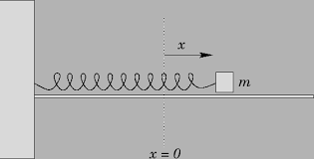
Hooke’s Law
Hooke’s law is about the relationship between a force and the distance it is displaced.
Y axis
X axis
Forces may change the shape of an object. ... When an object, such as a spring, is stretched, the increased length is called its extension. Hooke's law: The extension of a spring is directly proportional to the force applied, provided that the limit of proportionality is not exceeded.
https://www.bbc.co.uk/bitesize/guides/z4fmkmn/revision/3#:~:text=Forces%20may%20change%20the%20shape%20of%20an%20object.&text=When%20an%20object%2C%20such%20as,of%20proportionality%20is%20not%20exceeded.

