Slide 1
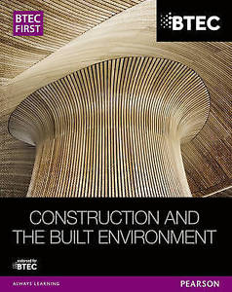
Name: ………………………………………………………………………………….
School: …………………………………………………………………………………
Construction Technology
Unit 1 = Exam
Read and Revise from this booklet
Answer all questions on the last three pages of this booklet.
To see past Exam papers go on line and search for https://qualifications.pearson.com/en/support/support-topics/exams/past-papers.html - BTEC FIRSTS - Construction and the Built Environment – Select Exam paper.
For your information - the text book that we are using in class is available from EBAY and other suppliers

Slide 2
CONTENTS
*PERFORMANCE REQUIREMENTS
Strength And Stability
Fire Resistance
Thermal Insulation
Thermal Resistance
Sound Insulation
Weather Resistance
Sustainability
*COMMON STRUCTURAL FORMS FOR LOW-RISE CONSTRUCTION
Traditional cavity wall construction
Cross Wall- construction
Sustainability Insulated Panels(SIPS)
*PRE-CONSTRUCTION WORK
Desk-Based Pre-Construction
Pre-Construction work on the site
*SUB STRUCTURE GROUDWORKS
-Hazards Associated With Groundworks
-Control Of Water
-Earthwork Support
-Foundations
-Ground Floors
*SUPERSTRUCTURE- WALLS
-Detailing a Wall
-Materials Used
-Wall finishes
-Wall openings
*SUPERSTRUCTURE-FLOORS
-Materials
-Floor Finishes
-Floor components
*SUPERSTRUCTURE- ROOFS
-Function of a roof
-Details of Roofs
-Components and Materials
ASSESSMENT QUESTIONS AT THE END TO USE FOR REVISION.
HAVE A GO AT CREATING YOUR OWN AND GET PEOPLE TO TEST YOU.
ASK FOR HELP IF YOU NEED IT.

Slide 3
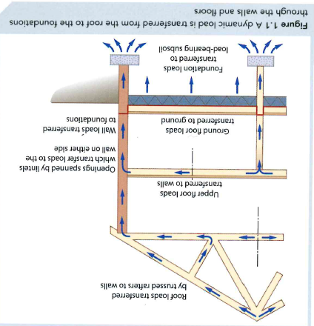
PERFORMANCE REQUIREMENTS
1
STRENGTH AND STABILITY
Loads are the various forces acting on a structure such as a building and they are as follows:
DEAD - THIS IS A LOAD THAT DOES NOT MOVE, SUCH AS THE WEIGHT OF THE BUILDING ITSELF.
DYNAMIC - THESE ARE LOADS THAT CAN CHANGE DURING THE USE OF A BUILDING. SUCH AS THE LOAD FROM PEOPLE AND FURNITURE .
IMPACT- THIS IS WHEN SOMETHING HITS A BUILDING OR FALLS ON IT, SUCH AS A HEAVY OBJECT
ACTIVITY 1
IN THIS BUILDING TRY TO FIND ALL THE DEAD, DYNAMIC AND IMPACT LOADS
IMAGE FROM BOOK
DEAD-
DYNAMIC-
IMPACT-
KEY TERMS
Performance - how well a building provides a comfortable, safe environment for its occupants.
Stable - when a structure can keep its balance without moving.
Sustainability - preserving resources for future generations and minimising the impact of construction activities on the natural environment.
THE LOADS DEPEND UPON THER LOCATION OF THE BUILDING. THESE LOADS ARE TRANSFERRED FROM THE ROOF TO THE FOUNDATIONS THROUGH THE WALLS AND FLOORS LIKE THE IMAGE. A BUILDING IS STRONG IF IT CAN RESIST THESE LOADS.
ACTIVITY 2
Which parts of the building that we are in are holding it together?
Are you putting any load on the building? What type of load is this?

Slide 4
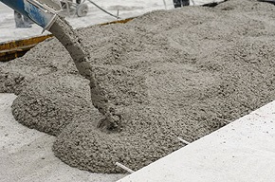
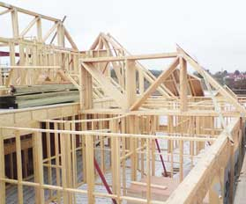
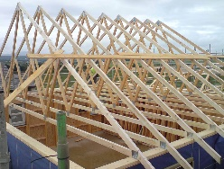



PERFORMANCE REQUIREMENTS
2
TESTING AND GRADING MATERIALS
The strength and stability of a building depends on the materials used to construct it. These materials are tested to make sure they have the needed strength
CONCRETE-
Is commonly found in foundations and floors so its strength is really important. Tests are done to make sure its strong enough
T-
-Slump testing checks the ratio of water and cement, if the wet concrete slumps and loses it shape easily then the balance is not right.
-Compressive strength testing checks that the hardened concrete is strong enough to withstand loads
Key term-
Ratio- the proportion of one thing to another.
ACTIVITY 3
FIND EXAMPES OF WHERE TIMBER IS USED IN CONSTRUCTION
T
-Timber -the strength of timber is tested and then sorted into various groups. This is called stress grading or strength grading
ACTIVITY 4
MORTAR- TESTING IS PERFORMED BY MAKING CUBES OF MORTAR TO CHECK HOW MUCH WATER CAN PASS THROUGH IT OR IF THERE ANY GAPS
DESCRIBE WHAT MORTAR IS
EXPLAIN WHERE MORTAR IS USED AND WHY
SPECIFYING AND GRADING MATERIALS
A designer tells the construction team about the materials to be used, this is a material specification.
The materials selected will comply with British or European standards. It is important materials meet these standards because it makes sure the building has the right strength.

Slide 5


PERFORMANCE REQUIREMENTS
3
Strength of materials are classified and graded
The strength of a material is calculated by working out how much pressure it can take.
The measurement is Newtons per square millimetre (N/mm2)
Concrete- strengths range from 8 N/mm2 to 60 N/mm2
When specifying materials, concrete with a strength of 25 N/mm2 is written a C25.
Timber- timber range from 14 N/mm2 to 70 N/mm2
Coniferous is written as C and ranges from C14 to C 50
Deciduous is written as D and ranges from D30 to D70
ACTIVITY 5
ACTIVITY 6
Convert these concrete strength into the correct code:
9 N/mm2____________
52 N/mm2__________
17 N/mm2__________
36 N/mm2__________
Highlight the strongest and weakest concrete.
Find the definition for:
Coniferous-
Deciduous-
Bricks - they are classified depending on how moisture they can absorb. All bricks should be at least 5 N/mm2. The standard for bricks is BS EN 771
Hardcore - is used to provide an even base for floors. It is a mix of gravel, sand, broken bricks and crushed concrete, also known as aggregate. The bigger the pieces in the mix the higher the classification.
Mortars - are a bond between courses of brick and blockwork. These are classified by where they are used. A mortar used for general purpose is known as G. Other classifications are based on how its made for example factory based or site based.
BS EN 998 is the standard
ACTIVITY 7
What are the standards for timber and hardcore?
Explain why the standards are so important for construction?

Slide 6
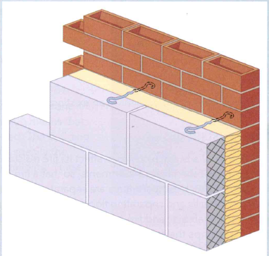
PERFORMANCE REQUIREMENTS
ACTIVITY 8 Cavity Walls
Cavity walls are constructed as two halves called skins. The gap between the skins is the cavity., which can be normally filled with insulation above ground level. Below ground level the walls will be constructed on top of the footings which is a layer of concrete which keeps the wall stable.
As they are constructed wall ties are put in place to connect these together?
Why do you think this is?
__________________________________________________________________________________________
Find out exactly where a bricklayer should place their walls ties when constructing a cavity wall
Fire resistance
Fire- resistant buildings can save lives and damage to property. Fire resistance can even make sure a building stays standing after a fire.
Fire resistant materials
ACTIVITY 9 Find out how each of these materials can be fire resistant
Plasterboard Concrete Blockwork Intumescent paint
The design of a building can also affect its fire resistance. Buildings can be separated into sections called fire compartments, this means that one compartment will not affect the others. The compartments are separated by fire barriers.
These include:
Fire walls and separating floors made out of concrete
Door closers to stop doors being left open which could help spread the fire
Fire resistant doors that are made from steel and painted intumescent paint
These all stop the spread of fire

Slide 7
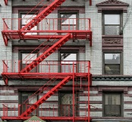

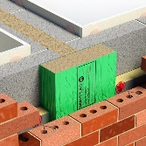
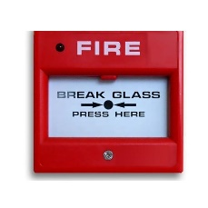
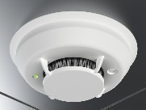
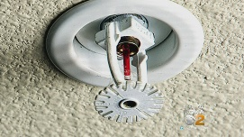
PERFORMANCE REQUIREMENTS
Equipment for fire resistance
Other features can also be used to stop fires occurring or spreading, or to make a building safer if a fire does break out.
ACTIVITY 10 Find out how these can help with fire resistance or make a building safer.
Fire escapes
Refuge areas
Cavity fire barriers
Fire alarm systems and smoke detectors
Sprinkler systems
Thermal insulation
Buildings have to be heated to make them comfortable to live in. Buildings are not air tight and so lose heat easily through gaps in the materials used to build them. This is why we insulate them. A building with poor insulation will use more energy to heat up but one that is well insulated will be cheap to maintain as less heat will escape.
A U-value is used to measure heat loss from any building. The lower the U-Value the better the building is insulated. Building regulations approved document L specifies the U-Values for various elements of a house.
Element of building | Highest acceptable U-value
Roof | 0.20 W/m2K
Wall | 0.30 W/m2K
Floor | 0.25 W/m2K
Windows | 2.00 W/mK2
A house has recently been built and you have been asked to check whether it has the right U-values. Use the table to help you.
-Floor 0.22 W/m2K
-Windows 1.98 W/m2K
External walls 0.70 W/m2K

Slide 8
PERFORMANCE REQUIREMENTS
Types of insulation
There are lots of different kinds of insulation and it is important to choose the right one for the job.
Type | Made from | Advantages | Disadvantages
Sheep’s wool | Wool | Can be reused and recycled Absorbs extra moisture | Has some non-renewable material Thermal conductivity can increase if compressed
Glass fibre or glass mineral wool | Recycled glass and silica | - Fire resistant - Does not rot - Can be recycled | Made from silica, which is not a renewable material Carbon emissions during its production
Rock mineral wool | Rocks | Fire resistant Does not rot Can be recycled | Production is not environmentally friendly Can irritate skin
Cellulose | Recycled newspapers | Made from recycled material Can be reused and recycled | Paper dust during installation Can release gases from the ink on the paper
Foam | Crushed glass | Can be recycled Has good compressive strength | - Production is not environmentally friendly
Thermal resistance
Buildings can also be constructed from materials that resist the movement of heat. This means that less heat escapes through them and so they need less insulation. These materials have thermal resistance and they include:
Aerated lightweight concrete blocks - these are blocks made from concrete with a lot of air in them. Air is very insulating when it is trapped between solid layers, e.g. when it is cold you will put on a jumper and the air you trap between you and the jumper will add as extra insulation. So these blocks add as better insulation.
Timber - this can be used to create features such as window frames and doors. It can also be used to construct timber-framed buildings.
Lightweight screed - this is made with lightweight aggregates. These contain more air, so lightweight screed gives good insulation.

Slide 9
PERFORMANCE REQUIREMENTS
Location
Some areas of a building are more likely to lose heat than others, This table shows which types of insulation are best for different types of a building
LOCATION | APPROPRIATE INSULATION
Cavity walls | The cavity in a cavity wall can be filled with an appropriate insulating material such as cellulose or mineral wool.
Solid walls | Plasterboard can be used to line solid walls and help reduce heat loss
Roof | Mineral wool insulation could be used between joists
Floors | Sheep’s wool insulation could be used under floors
Windows and doors | Double glazing improves a building’s U-values by stopping unnecessary heat loss - Draught strips can be applied to door frames to improve air-tightness of doors by stopping draughts.
Sound insulation
A building should be insulated to resist letting sound through its structure. Buildings have to be insulated against this noise. Like thermal insulation, there are lots of different types of sound insulation.
ACTIVITY 11 Research where these different types are used and why:
- Triple glazing- _________________________________________________________
- Heavy density blockwork- _______________________________________________
- Sound insulation quilt-__________________________________________________
-Plasterboard layers-_____________________________________________________
-Flooring mats and carpeting-_____________________________________________
-Acoustic ceilings-_______________________________________________________
ACTIVITY 12 You are planning a new arts and drama building for your local college or school. The building will have:
A music studio
Two drama performance studios
Six music practice room
A dance studios
What sort of insulation will you need and where will you need it. Give reasons for your answers

Slide 10
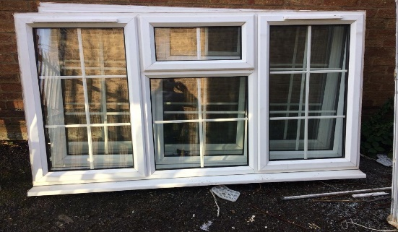
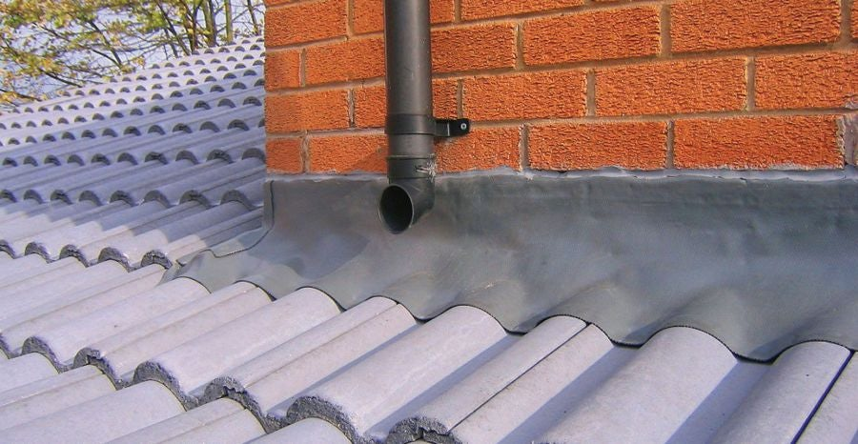
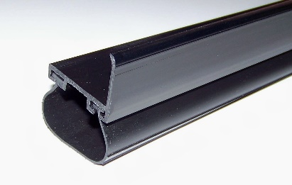
PERFORMANCE REQUIREMENTS
Provision of sound insulation:
Good sound insulation can be achieved by:
- Increasing the density of material. This means that the speed of sound trying to pass through these materials is slowed down.
Using robust design details. Making sure in the drawings that a building has a the correct sound insulation.
Dividing the building structure in a way that sound from one part does not travel into the other part.
Using machinery silencers. These help reduce the noise from machinery used in the construction process.
Weather Resistance
All buildings should be weather resistant to avoid rain damage, have protection from the cold and heat and any other weather related problems. Damage to the walls from rainwater and other elements can reduce a building’s useful life.
Buildings are made weather resistant using waterproof and impervious materials like these;
Materials like PVC- these can include guttering, soffits and window frames as the plastic is very weather resistant.
Rubber weather seals and sealants- these are applied to doors and windows to stop water entering.
Weather stripping- these are strips of vinyl that are used to close the gaps in a door or window to make it weatherproof.. Draught strips are also used to avoid losing heat.
Falls- these are slopes on the outer parts of doors and windows so the rainwater runs away.
Overhangs- overhanging eaves of the roof mean that the rainwater runs away from the building.
Flashings- these are metal sheets used on the roof between the roof and chimney to avoid water getting in the roof.

Slide 11
PERFORMANCE REQUIREMENTS
ACTIVITY 13 Sustainability
A sustainable building is designed and constructed in a way which has the least impact on the natural environment. Research and find what sustainability is aiming to do (at least 3):
Methods of sustainable construction
Sustainability must be in the design to achieve it. To achieve it you can:
Reuse brownfield sites. This reduces the number of greenfield sites that are used for construction and so keeps a maximum of green space untouched. As brownfield sites have already been built on, it may also mean that less energy would be needed to develop sites.
Achieve maximum sunlight through building orientation. A building facing south in the UK will get the most sunlight and so will need less electricity.
Reduce time and wastage by using local suppliers and using prefabricated(already made) materials.
Recycle site waste by separation and then reuse these.
Recycle waste materials
Use sustainable materials that are from renewable sources in construction activities e.g sheep’s wool can be regrown
Material | Sustainability
Hemp | Very widely grown, excellent insulation properties
Lime | This is a natural renewable substance used to make mortar. Lime based mortar can be removed when a structure is knocked down which means it can be recycled.
Cedar | This is a type of wood that us used for cladding. It has natural resistance to moisture and humidity and gives excellent insulation
Softwoods | Use for timber framed buildings, these can be grown quickly in a sustainable way.
Straw | Straw bales can be used to build walls and even entire houses.
Sheep’s wool | Can be used as insulation, more sustainable than that artificial insulation materials.
Aluminium | This is a soft metal that is easily melted down and recycled.

Slide 12
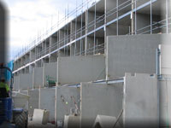
COMMON STRUCTURAL FORMS FOR LOW-RISE CONSTRUCTION
Traditional cavity wall construction
In a traditional cavity wall construction
The walls and foundations are usually the loadbearing elements of the construction
The external walls are normally constructed as cavity while internal walls are solid or partition walls
The external cavity walls have an outer skin or brickwork and inner skin of blockwork
The outer skin can also be rendered to provide extra insulation
ACTIVITY 14 Why do you think cavity walls are used as external walls?
________________________________________________________________________________________________________________________
Cross-wall construction
In cross-wall construction, the front and back of the building is constructed as non-loadbearing, while the load bearing walls are at right angles to these walls. This leads to the name cross-wall. The floor between these cross-walls is connected to all four walls and provides lateral restraint.
This is suitable for flats or apartments, as it is ideal for creating similar floors. These are quick to make and can be done off-site. Sometimes the cross-wall meets are not weatherproof.
ACTIVITY 15 Structurally insulated panels (SIPS)
These are insulated timber panels that are strong enough to take loads. They have a central layer of insulation, with plywood either side. These are made quickly that provides a lighter frame that helps reduce site waste. Because they are wooden they are a small fire risk.
Fill in the advantages and disadvantages of using SIPS and types of buildings they are used in.
Advantages | Disadvantages | Types of buildings that use SIPS

Slide 13
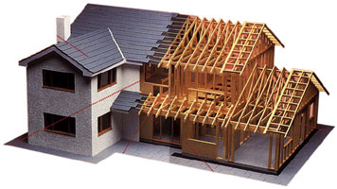
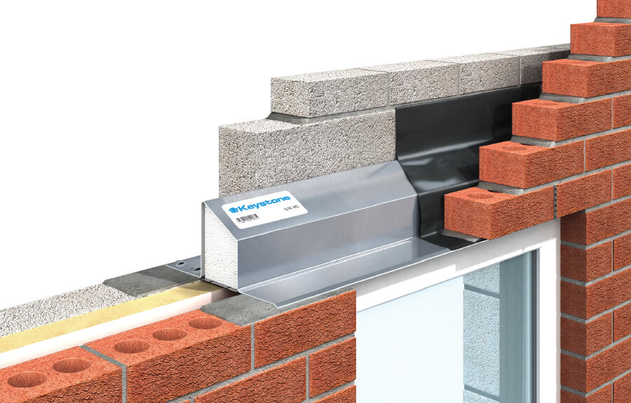
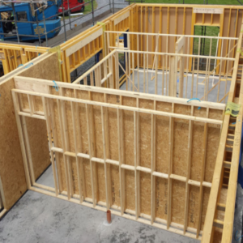
COMMON STRUCTURAL FORMS FOR LOW-RISE CONSTRUCTION
Timber framed construction
Timber framing is commonly used in houses. The frames are made of softwood and covered with plywood. Loadbearing timber walls are made up of small timbers called studs. Noggins go in-between the studs.
The most common parts of timber framed buildings and their functions are:
Damp proof course- A damp proof course stops moisture coming in from the foundations and damp proof membrane stops is put under the floor for the same purpose.
Finishes- Timber framed buildings can be finished like any other building and can be covered with a brickwork finish and attached with wall ties.
Insulation- This is put in-between the studs and tied so that there are no gaps.
Lintels-are used at openings like windows and doors to direct rainwater away from the opening.
Studs- these are the upright parts of the timber frame
Moisture resistance- a polythene sheet called a vapour check is built in-between the internal wall and the insulation to stop moisture.
Plywood sheets- these are attached to the external walls to provide bracing.

Slide 14
PRE-CONSTRUCTION WORK
Desk based pre-construction
Before work starts on site, a range of activities need to be carried out:
-Health and safety plan, method statements and risk assessments. HSE need to be informed
- Scaled site plan needs to be drawn up. This shows where things like site offices and materials storage should go. Things like welfare facilities like toilets and storage accommodation. Needs fences, temporary roads and fire precaution measures.
-A programme of work or schedule of activities is produced. This should plan out deliveries or resources and materials.
-Resources and materials are bought.
-Safety signs set out round site and tell local public about possible road closures
-Road crossings for plant and deliveries to be organised. Traffic needs to be though about.
Pre-construction work on site
-The site is cleared of vegetation and trees
-Any existing structures knocked down
-Services like water, gas and electricity and protected from damage
-Access and exit routes into and out of site are constructed
-The site is set up providing accommodation and services including lighting
-Roads are put in place
-Security is installed like fencing, CCTV and gates
SUB-STRUCTURE GROUNDWORKS
Hazards associated with groundworks
This table shows how groundwork hazards can be controlled
HAZARD | RISK | CONTROL MEASURE
Gas | Injury or death | Avoiding services such as gas mains
Presence of ground water | Flooding or drowning | Pumping out excess ground water
Confined space | Crushing or musculoskeletal | Use the right PPE and reduce amount of work done in small spaces
Existing services | Injury, death, flooding or power outages | Locate and protect all existing services before work begins
Proximity of excavation plant | Injury or death | Barriers stop moving machinery getting close to excavation.

Slide 15
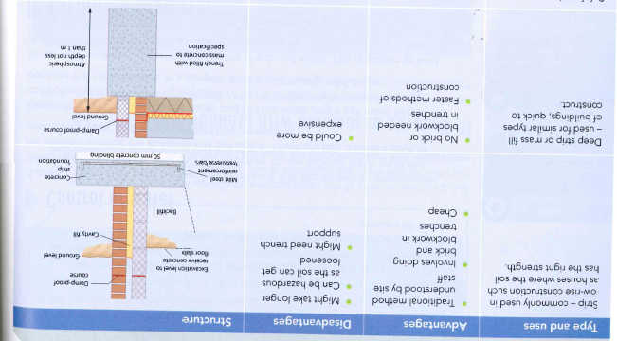
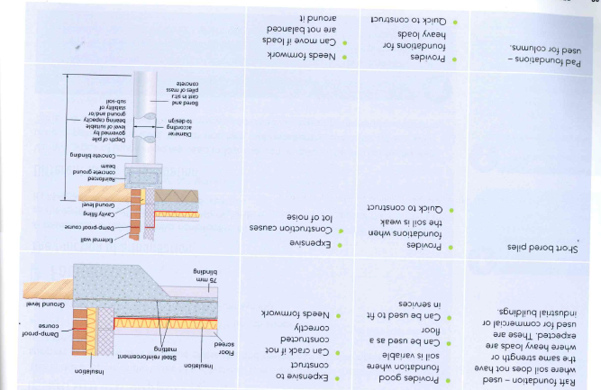
SUB-STRUCTURE GROUNDWORKS
Control of water
Sub-soil water is present below the ground. It is also known as groundwater. During the design and build process, sub-soil water must not be allowed to enter the building and damage it.
We can do this in a temporary way by using a simple sump pump where the water collects in a sump and then is pumped out.
A more permanent way is land drainage and there are several methods of land drainage.
Earthwork support
This is the support of the sides of excavation. There are different methods of earthwork support depending on the needs of the site and the type of soil you are digging, these include:
Steel trench sheets
Hydraulic trench supports
Timbering
Aluminium walling
Foundations
The function of a foundation is to safely limit the load to the ground or sub-soil. They should support the building for its lifespan.
There are different types of foundation and they depend on the structure, site requirements and soil as can be seen below.

Slide 16
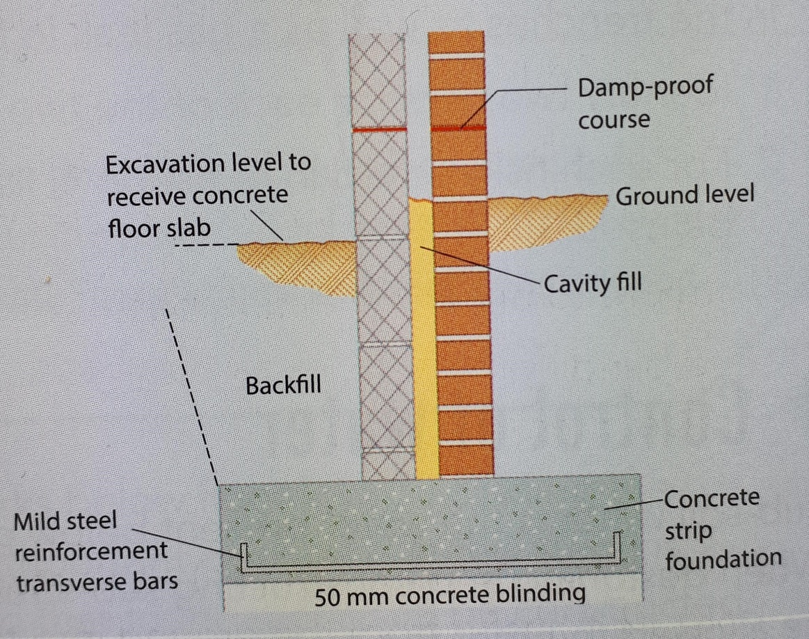
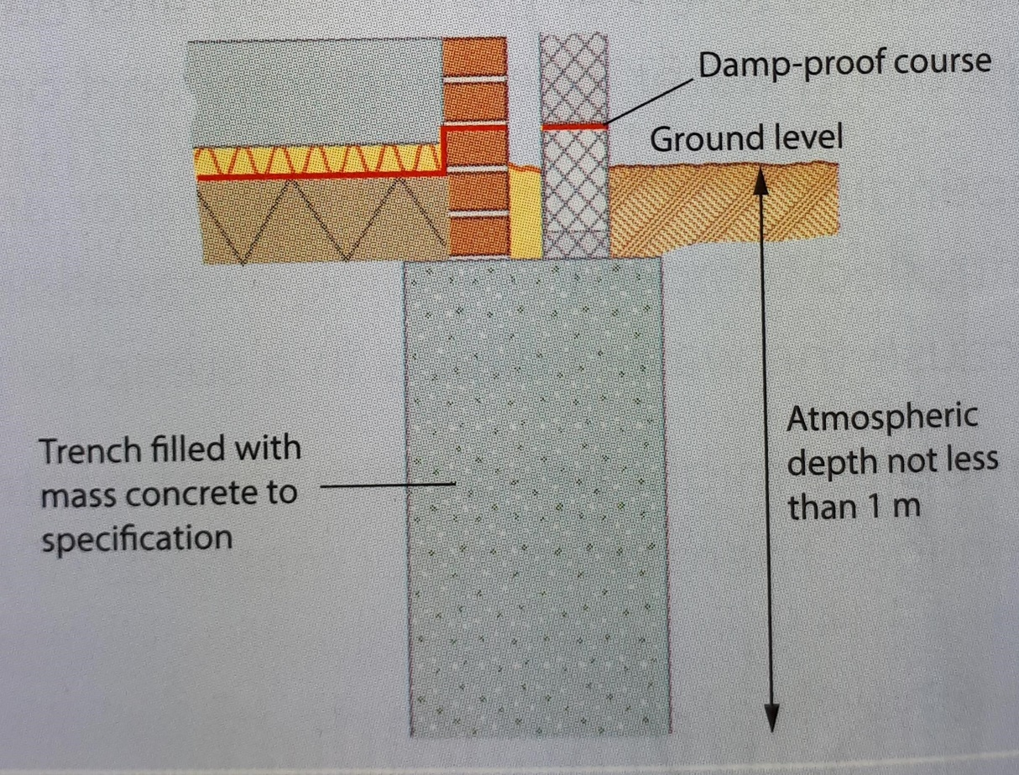
STRIP FOUNDATION
DEEP STRIP or MASS FILL FOUNDATION

Slide 17
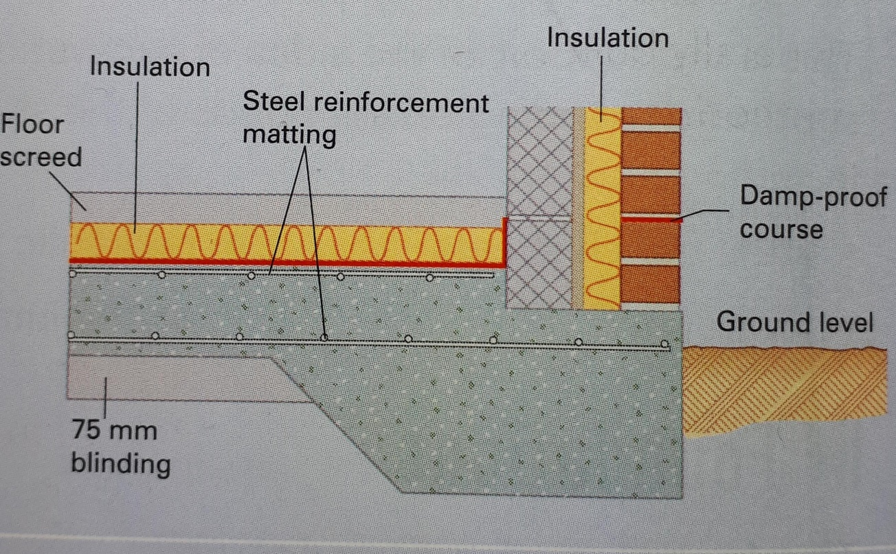
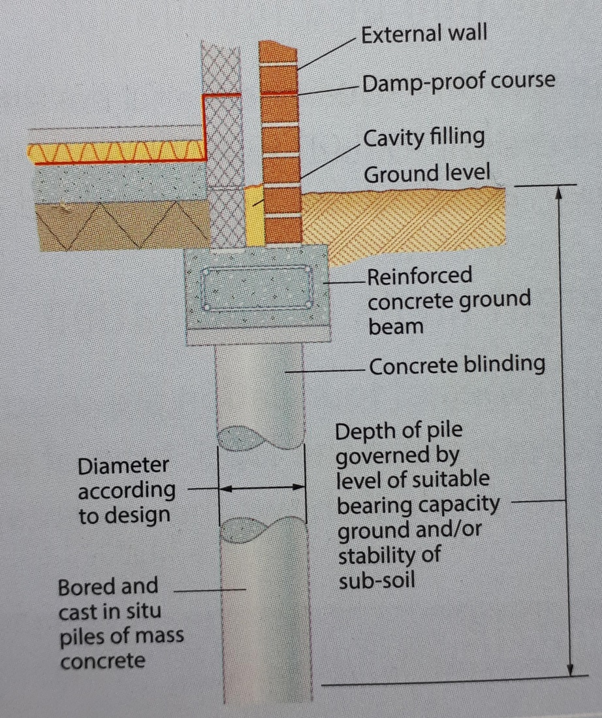
RAFT FOUNDATION
SHORT BORE PILES

Slide 18
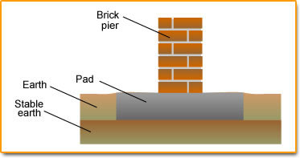
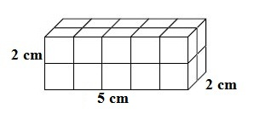
PAD FOUNDATION
MATHS
Construction workers must use maths in a variety of ways while practicing their trade, including taking measurements, estimating the amount of concrete needed in a foundation pour, converting quantities and solving equations. Construction workers must be able to add, subtract, divide and multiply as well as work with fractions.
There are two layers with 10 cubes in each layer. The
volume is 20 cubic centimetres.

Slide 19

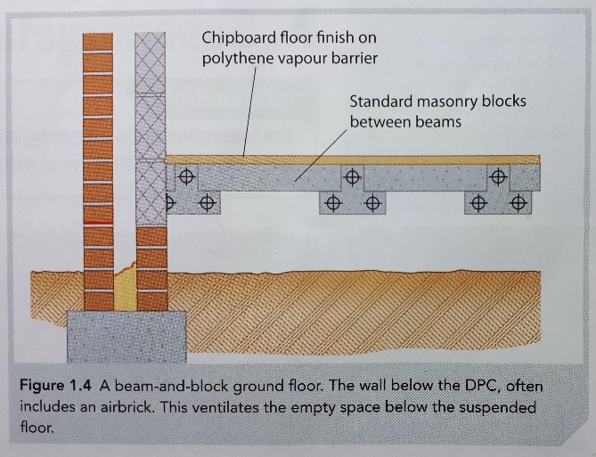
SUB-STRUCTURE GROUNDWORKS
Ground floors
Ground floors can be either solid or suspended.
A solid floor bears directly onto the ground from which it gains support. It is usually made up of concrete or:
-Hardcore to provide a strong base
-Sand blinding- this is a layer of sand to even off the hardcore
-Damp proof course
-Damp proof membrane- this stops moisture from the ground into the building
-Insulation should have good compressive strength
Suspended floors is one that is suspended above ground. It rests on beams spanning between supporting walls. In modern construction these are built using the beam and block method.
Beam and block floor
This is a type of suspended floor. It uses pre-cast concrete beams with lightweight concrete blocks as an infill. It is very popular as they are quick to construct and ensure high quality. They can be laid in bad weather because they are pre-cast and also put on less of a load on the foundations.
Figure 1.3 Typical solid Floor Details
SUPERSTRUCTURE- WALLS
A wall performs a number of functions such as:
Resisting heat transfer
Reducing sound transmission
Transferring loads to foundations
Providing shelter and security

Slide 20
SUPERSTRUCTURE- WALLS
Detailing a wall
This is the process of producing a drawing that contains all the details about the construction of a wall, such as materials and the size.
Internal partitions or walls are constructed to divide the floor area of a building into smaller and more useful spaces such as an en-suite bathroom. Internal walls can be constructed as either timber studs walls, blockwork walls or aluminium stud partition walls with windows and doors or panes of glass included.
Materials used
Walls can be finished with brickwork but must be careful of colour variations so the look is pleasing as possible.
Mortar is a mix of sand and lime or sand and cement. Lime makes it more workable but also makes it porous which means it easily lets moisture through. This could lead to frost getting in and causing damage.
Thin joint masonry is a faster method of constructing walls. A fast setting mortar can be used which can give strength quickly. The masonry depends on the accuracy of block sizes. Lightweight blocks are often used which also gives good thermal efficiency.
Wall finishes
Rendering blockwork is a process similar to plastering and with render you can achieve different textures.
Facing brickwork usually has various types of joints with pointing. Joints improve the weather-proofing and the appearance of the brickwork.
Wall openings
Openings have to be included in walls to provide:
Ventilation
Sunlight
Aesthetics (attractiveness)
Components of wall openings and their functions
component | function
Lintel | A horizontal support across the top of a wall opening, such as over a door or window
Sill | A piece of material below a door or window to allow rainwater to run off/away from the opening.
Threshold | A strip of material forming the bottom of a doorway
Cavity tray | A damp-proof course inside a cavity wall, which funnel moisture out of the cavity through weep holes.
Cavity closer | This closes of the cavity around a wall opening, reducing heat loss
Weep hole | A small opening in brickwork which allows moisture to escape.

Slide 21
SUPERSTRUCTURE- FLOORS
Materials
Floors are constructed using a wide range of materials. These include:
-Concrete- beam and block floors use pre-cast concrete beams with lightweight concrete blocks as an infill.
-Timber-Suspended floors can be constructed using different types of timber joists, which are like beams and support the floor load. These can be made of natural or man-made timber products. Some joists are not solid and have open areas providing spaces for wires and pipes. These are eco-joists and use less timber.
-Engineered timber-newer buildings may have floors made of applied finishes such as laminate and engineered timber. These need less maintenance and are also less likely to be affected by moisture and defects such as rot.
Floor finishes
Solid floors can be finished in screed, which provides a level and even surface. Additional floor finishes such as carpets can be laid on top of this.
Floors could be finished using ordinary chipboard, moisture-resistant chipboard or softwood. A wooden board called a skirting board is provided along the bottom of the wall. This is used to make the joint between the wall and the floor look more attractive and protects the wall base as well.
Floor components
The floor is made up of joists or beams suspended between supporting walls which support the load from the floor. Joists are supported by the walls. They can either rest on the wall or be connected using special components called hangers. These are attached to the side of a wall and receive the joists.
SUPERSTRUCTURE- ROOFS
Functions of a roof
Roofs are designed and constructed to be able to support their own weight as well as resist loads due to their finishes and other loads such as snow and wind. A roof should:
-Discharge rainfall away from the building
-Make the building waterproof
-Be aesthetically pleasing, through the use of attractive roof tiles and finishes
-Provide extra accommodation or space

Slide 22
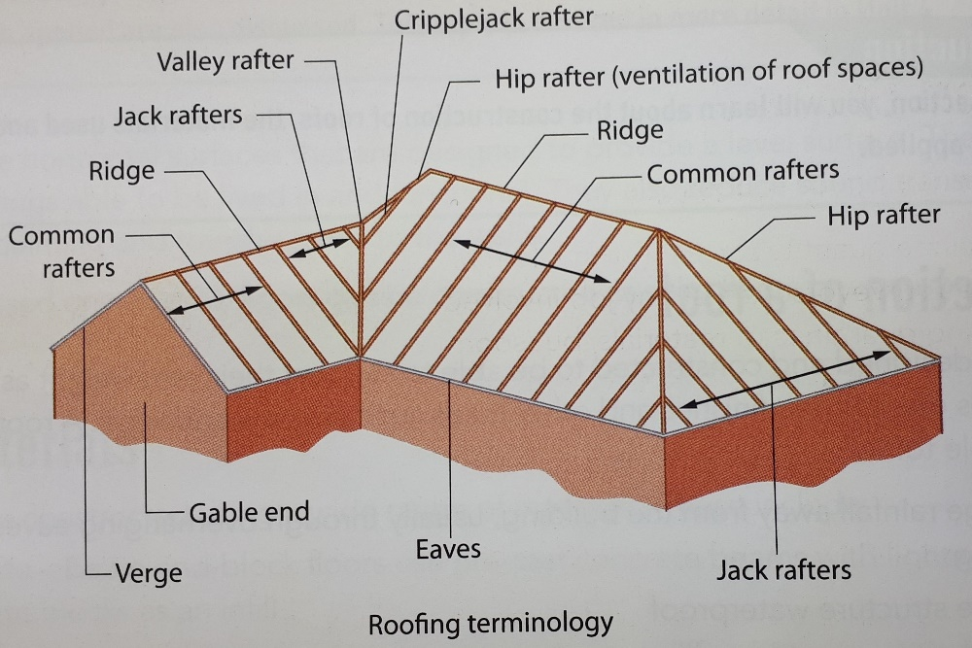
SUPERSTRUCTURE- ROOFS
Details of a roofs
A roof can be constructed as flat or pitched. Types of pitched roofs can include lean-to, mono pitch, double pitch, gable end and hipped-end.
As there are lots of different types of roofs, it is important to consider the performance requirements of the building before deciding on which kind of roof to construct.
Type | Advantages | Disadvantages
Flat Roof | Aesthetically pleasing Provides parapet feature in the building Ease of maintenance Forms recreational areas | Water run-off may be difficult, causing puddles on the roof Solar reflective paint required, which needs to be maintained Extra hardwearing surfaces might be needed
Pitched Roof | Aesthetically pleasing Creates more floor space or storage space Better water run-off Less maintenance needed | Initial cost higher than flat roof Takes longer to build Difficult to access for maintenance
Roofing terminology

Slide 23
SUPERSTRUCTURE- ROOFS
Components and materials
A roof is made of components that support the load or weight of the structure. These can made of timber, concrete or steel. Insulating materials and materials to provide resistance to moisture are also used. Pitched roofs are finished using a variety of tiles such as natural slates, clay and concrete tiles.
A flat roof is finished using waterproofing materials. Both flat and pitched roofs drain rainwater away through a system of drainage pipes.
ASSESSMENT PRACTICE
Look at the marks, this shows how much information you should give.
A timber classified as C45 is: (1)
A- a hardwood
B- planed all round
C- a softwood
D- deciduous
2. Wall ties are provided: (1)
A- so that the wall looks good
B- for no particular reason
C-only horizontally for stability
D- both horizontally and vertically for stability
3. Identify two fire resistance measures that have been provided in your school building. (2)
4. Explain the functions of: (2)
Fire barriers
Sprinkler systems
5. Explain the difference between sheep’s wool insulation and foam insulation. (4)

Slide 24
ASSESSMENT PRACTICE
6. Identify two materials that would give good roof insulation in a terraced house. (2)
7. Chris is designing a house for a client who is interested in sustainability and wants to keep their future energy costs as low as possible.
Name two areas or elements of the proposed building that are most likely to lose heat. (2)
For each area or element named in the question above, suggest a suitable insulation material. Give reasons why you have chosen that material. (4)
8. Identify four measures you could take to make a house weather resistant. (4)
9. Identify any four elements of a sustainable building. (4)
10. Sketch and label the cross-section through and external cavity wall. (4)
11. Identify two advantages and two disadvantages of SIPS construction. (4)
12. You are on site carrying out groundworks. You are told that there is groundwater in the trenches as well as a gas leak in the confined space of the excavation.
Identify two risks for each of the two hazards mentioned above. (4)
For each risk named in the question above, list one control measure that could be used.

Slide 25
Describe
ASSESSMENT PRACTICE
13. Identify three components of a wall opening. (1)
14. The function of a wall opening is to provide:
A- ventilation, fresh air and water
B- ventilation, light and aesthetics
C- aesthetics, light and weep holes
D- a view of the landscape
15. Describe one advantage and disadvantage of two kinds of pithed roof. (4)
16. Identify four components of a pitched roof. (4)
Explain
Make your point.
Give an example.
Make your point.
Give an example.
Explain why.
One way that…
For example…
We see this…
This shows…
An example of this is…
This is demonstrated by…
This happens because…
The reason for this could be…
This may happen as…
The meaning of this is…
The problem with this is…
Because of this…

