Slide 1
Personal Protective Equipment
(PPE)

Slide 2
PPE - variety of clothing / equipment to protect against injuries and accidents
Some PPE is used occasionally; some is used daily
Type of PPE you wear depends on what you are doing and where you are

Slide 3
Types of PPE

Slide 4
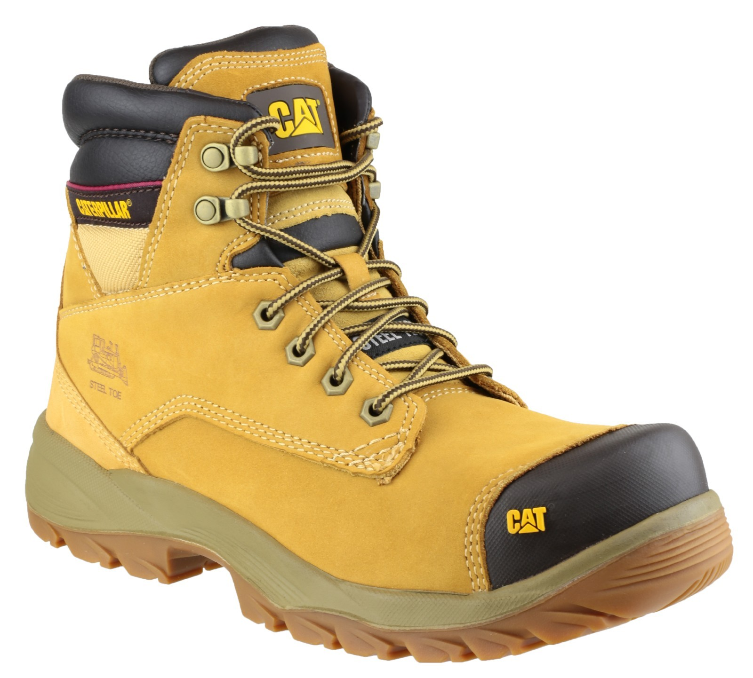
Foot Protection
This is compulsory on site
Steel toecaps – protects against dropped items
Steel sole plate – protects from nails, etc
Good grip – helps traction on slippery surfaces
Discuss…

Slide 5
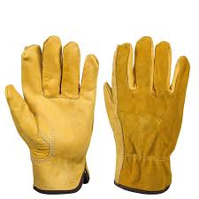
Hand Protection
Prevents damage to hands and fingers
Can prevent cuts
Prevents skin irritation and inflammation
Discuss…

Slide 6
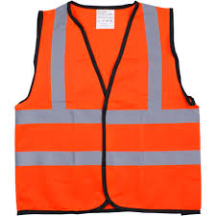
Protective Clothing
Hi-vis jacket or vest
Overalls
Waterproof over trousers
(kept clean and in good condition)
Discuss… (also responsibilities of employer and employee)

Slide 7
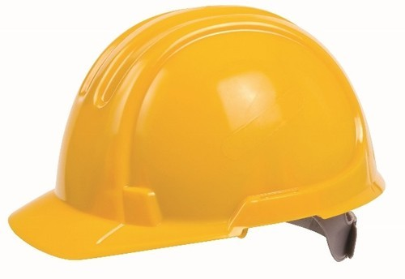
Head Protection
Safety helmets are compulsory on building sites
Protect against head injury
They must fit well and be regularly inspected
Recommended replacement – around 3 years
Discuss…

Slide 8
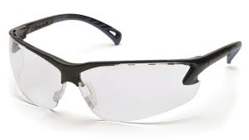
Eye Protection
Safety glasses or goggles
Stops objects getting into eyes
Discuss…

Slide 9
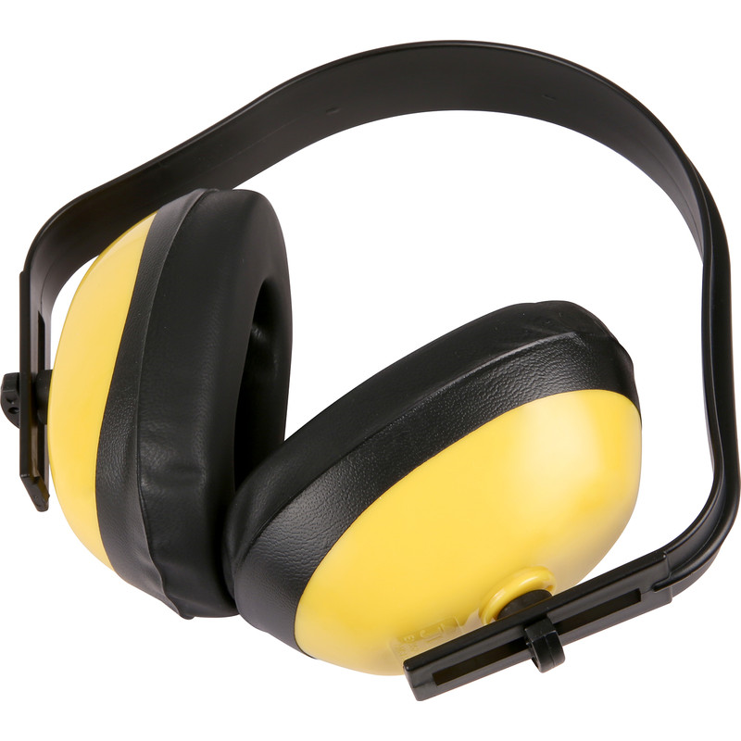
Hearing Protection
Ear defenders
Ear plugs
Discuss…

Slide 10
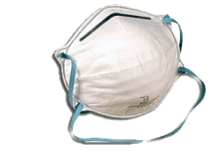
Respiratory Protection
Ensure you have right mask for the job
It must be fitted properly
Discuss…

Slide 11
PPE Legislation
Personal Protective Equipment at Work Regulations (1992) is one of the most important pieces of legislation
It explains your responsibilities, and your employer’s responsibilities
Also important are: Control of Substances Hazardous to Health (2002) and the Provision and Use of Work Equipment Regulations (1992 and 1998)
We will regularly discuss these important regulations in our work together

